Slide 1

Personalization and Adaptation in Learning Management Systems
Prof. dr. Paul De Bra
Eindhoven University of Technology
Notes:
The GRAPPLE project deals with adaptive technology-enhanced learning, more specifically with combining Learning Management Systems and Adaptive Learning Environments.

Slide 2
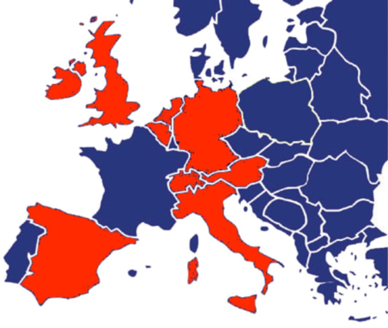
What is GRAPPLE?
EU FP7 STREP Project
  15 partners from 9 countries
  12 education/research, 3 companies
  budget 5.3 M€, subsidy 3.85 M€
  3 year project, Feb. 2008 to Jan. 2011
  main goal: delivering an integration between Learning Management Systems and Adaptive Learning Environments
Notes:
GRAPPLE was a 3 year EU project that aimed at turning adaptive learning into mainstream technology.
Currently most teaching or learning institutes are using a Learning Management System to offer learners access to services and learning material. GRAPPLE aimed at extending these LMSs with an Adaptive Learning Environment. GRAPPLE does this in such a way that the ALE can be used with any LMS.
15 partners from 9 countries have been working together in this project, each with specific knowledge and experience that is shown on the next slide.

Slide 3
GRAPPLE Consortium
user modeling architectures
adaptive e-learning
TU/e
TUDelft
L3S
DFKI
authoring
metadata
interfaces /
server technology
Warwick
TCD
OUNL
VUB
standards
learning design
ATOS
interaction
USI
UCL
eXact learning sol.
UCAM
IMC
industrial learning technology
open source learning management
UniGraz
evaluation
Notes:
Many competencies need to come together to achieve the goals of GRAPPLE.
We are not going to present all of the work done in GRAPPLE, but we concentrate on the most important aspects:
What is adaptive in GRAPPLE? What do we actually make adaptive in our view on Adaptive TEL or Adaptive E-Learning?
The key in GRAPPLE is that we combine Learning Management Systems and Adaptive Learning Environment through a common GRAPPLE Infrastructure. In GRAPPLE we connected five LMSs to our adaptive environment: Moodle, Claroline, Sakai, Clix and learneXact. Other LMS suppliers should be able to easily connect their LMS to GRAPPLE by studying how it was done for these five systems already.
The GRAPPLE Adaptive Learning Environment, or GALE, is the adaptation engine that takes care of adaptive course delivery. We will present the main features of GALE and show some of the adaptation in an example on-line course.
When you create courses for use within GRAPPLE you need tools to define the conceptual and pedagogical structure of each course. We will briefly explain and demonstrate the GRAPPLE Authoring Tool, or GAT.
An important aspect of GRAPPLE is its extensibility. If GRAPPLE offers 90% of what you want you can put in the additional 10% to extend the framework with what you want instead of 100% effort to develop everything from scratch. Within GRAPPLE we have four demonstrators of extensibility: adaptation to devices like mobile phones with limited screen space, visualization of user model data for individual users or uses groups, using data from GUMF, adaptation in simulations, and adaptation in virtual reality. The University of Lugano, Trinity College Dublin and the University of Lugano have worked on such extensions.

Slide 4

What is Adaptive TEL?
Technology-Enhanced Learning
= learning with the help of ICT
(e-learning and blended learning)
Adaptive means it involves
automatic personalization
  Knowing who the learner is is automatic
  Adapting to that learner is automatic
Notes:
For many years every type of computer use in the learning process was associated with the term E-Learning. However the term E-Learning became more or less synonymous for electronic distance learning, which isn’t enough any more. We needed a term that also covers blended learning: using on-line material and activities as well as off-line activities like lectures and assignments. The term Technology-Enhanced Learning covers this nicely because it says technology is involved but only enhances the learning and isn’t everything.
The term Adaptive has been abused a lot, so let’s make clear what we mean: it is about automatic personalization where the word automatic actually has a double meaning: the system needs to automatically decide what the personalization applies to, so it needs to decide who the learner is, what her properties are, without asking this explicitly, and then the adaptation itself needs to be done automatically, using the description of the learner.

Slide 5
LMS versus ALE
A Learning Management System (LMS)
  supports the learning process;
  offers a personalized context;
  helps the teacher and institute more than the learner.
An Adaptive Learning Environment (ALE)
  supports the learning process;
  offers personalized content;
  helps the learner, not the institute.
Notes:
GRAPPLE deals with Learning Management Systems and Adaptive Learning Environments.
These two types of systems serve a very different purpose:
A Learning Management System is a management tool: it supports controlling the process of learning. It allows learners to enroll in a course; it offers access to course material, on-line exams, handing in of assignment work, and perhaps discussion forums, messages, chat, etc. The LMS is a great tool for the teacher to “address” his students, and for the institute to keep track of the learner’s progress, grades, course enrollment and completion. For the learner the LMS is often a burden rather than a helpful tool. It may offer some personalized context: a learner can see which courses he or she can enroll in, and not be bothered with messages about other courses.
An Adaptive Learning Environment is a learning tool: it offers personalized course material and guidance. It keeps track of the learner’s progress in order to offer additional learning material when needed, enable tests only when the learner is prepared for them, etc. This type of tool helps the learner, not the institute.
You probably guessed it: Learning management Systems are popular because the institutes that offers them benefit from them. An Adaptive Learning Environment is not popular because it offers no direct benefit to the institute, only to the learners. And while we would hope that institutes are interested in helping the learner whenever possible, the reality is that they are not.
The main goal of GRAPPLE is to include an ALE in existing LMSs so as to automatically provide an ALE to every LMS user. And when you get a tool anyway the chances are higher that you will actually use it.
In GRAPPLE the GRAPPLE Adaptive Learning Environment is called GALE.

Slide 6
What do we adapt in GRAPPLE?
“Traditional” adaptation in TEL is course sequencing.
A course is a hypermedia application:
  navigation freedom through rich link structure
  adaptive link annotation to provide guidance;
  (based on prerequisites or learning style)
  pages (“nodes”) can be adapted to give additional or alternative explanations (or examples or illustrations)
We don’t want this!
Notes:
GRAPPLE is about adaptation, so let’s see what we mean by that.
Traditionally adaptation in TEL is implemented as course sequencing: based on things like prior knowledge or learning style a single learning path is calculated and learning material is presented in that order. Doing a test may result in a recalculation of the learning path, but as a learner you have no control over what you study next. WE DEFINITELY DO NOT LIKE THIS. WE WANT A DIFFERENT FORM OF ADAPTATION.
We consider a course as a hypermedia application. This means that we have information objects, like pages of text, illustrations, perhaps also audio and video fragments, or as we shall see later a virtual reality presentation. These objects are connected by hypertext links, that let the learner choose which page or object to go to. Adaptation in such a course is of two types:
Typically the learner can choose between many different pages to go to. Not all choices are equally suitable. Prior knowledge can be used to decide which pages are suitable. This is done by means of prerequisite relationships. But advice on which pages to go to can also depend on your learning style for instance.
The pages of a course can also be adapted. If needed the learner can get an additional or alternative explanation; perhaps the learner gets an additional example or gets an example before explanation or after the explanation depending on his/her learning style.
The adaptation in the course depends on which pages you already studied, but may also depend on results scored on a test that is served through an LMS.

Slide 7




Adaptive System Functionality
event ➔ user model
user model ➔ adaptation
Notes:
This diagram shows the functionality of an adaptive system in an abstract way.
Here is what happens:
The learner initiates a request, for instance by clicking on a link found on a page of learning material, or in a menu, of perhaps the “next” button in a guided tour.
The request generates an “event”. We do not necessarily record the “event” as such but compute what the event tells us about the learner. The event is translated into a “user model update”. The system maintains a model of the user in a database, and updates this model each time the user does something.
The request is a request for new learning material. This learning material is selected from a repository. It is possible that based on the user model the same request may result in the selection of different learning material. But also, the learning material is adapted (changed) to the individual learner, based on the user model.
The retrieved and adapted learning material is returned to the learner.
The most interesting bit here is that in theory there is no limit to how accurately the system can “model” the user, and there is no limit to how the system can “adapt” the learning material to the learner. And this is where all adaptive learning environments differ from each other: what information can they store about the learner, and in what way can they adapt learning material to the learner (based on that user model)?
So on the next slide we see the GRAPPLE approach to user modeling and adaptation!

Slide 8
Adaptation in GRAPPLE
User Model is in any data format
  any event you can record can be used
  any computation can be done:
  event + user model ➔ new user model
Adaptation is any transformation you can program
  any data format for the learning material
  adaptation based on all user model data
Notes:
The GRAPPLE philosophy is: ANYTHING GOES!
The user model can contain any data format, with any information that you can compute from any incoming event (compute using any programming language). The only restriction is that the new user model state must be computable from the data associated with the event and the old user model state.
The adaptation can be applied to any information data format, and anything you can change using any programming language can be adapted, based on any information from the user model
There are some restrictions on the use of information from other users’ user models in order to have some form of privacy and security in GRAPPLE. Until now we have concentrated on adaptation for a user based on knowledge about that user only. It is possible to define a “group entity” and have events contribute to a “group model” and adaptation based on a “group model” but we have not experimented with that at all within the GRAPPLE project.
Another restriction in GRAPPLE is that it is based entirely on the HTTP request/response paradigm. Serving and adapting information is only done when the browser sends a request to the server. In most cases such a request means the leaner clicked on a link or the submit button of a form. It is possible to have automated requests through Javascriipt to simulate a more continuous stream of communication between client and server.
In all that follows we will use an example where we define one specific type of user model and where we use Java code to define user model updates. We will use XML and in particular XHTML as the format for pages of learning material, and we will use Java code to change, insert or delete XML fragments or tags in this learning material, based on the learner’s user model. This is just an example of what we can do. We show this example because this can be done with the default GRAPPLE configuration, without requiring *you* to add support for different data formats and/or programming languages.

Slide 9
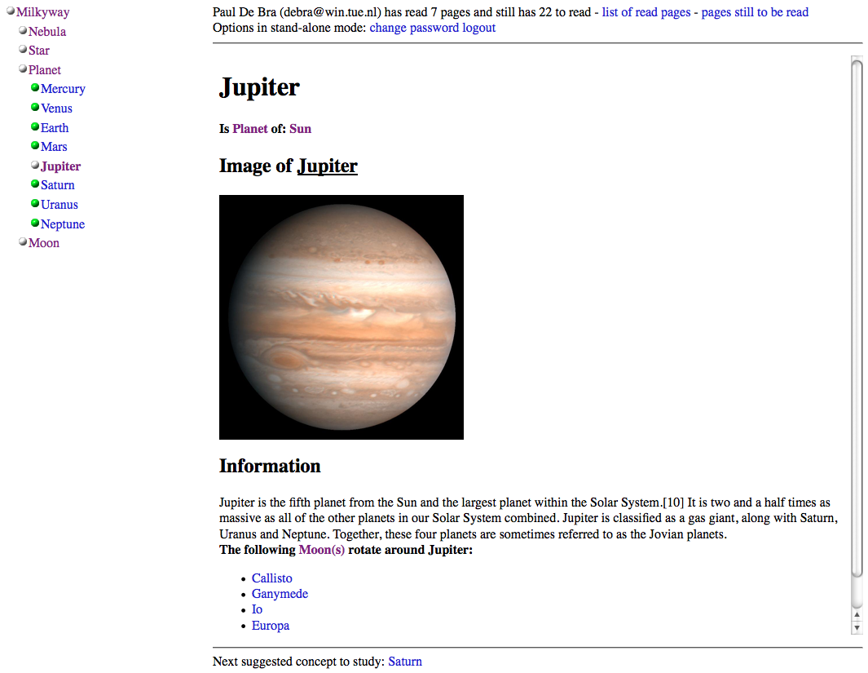
Notes:
Let us start by having a look at what the GRAPPLE Adaptive Learning Environment does.
What we are seeing here is a screenshot from a toy example called “Milkyway”. We studied a few pages from this course: Star, Sun (you don’t see that concept here), Planet, Moon and Jupiter. We recognize the blue/purple color scheme to indicate visited versus unvisited pages as well.
What’s typical in this type of course is that the learner has a lot of freedom in navigating the course. There is no prescribed order to study the different topics.
What do we see here:
There is a header that shows the name and email of the learner, number of pages read, number of pages still to do, etc. The adaptive system consults the user model to retrieve name and email and to count the number of pages read, and it consults a course model to see how many pages are there so it can produce the second number.
We see an accordion menu that shows part of the concept hierarchy of this course. This menu is generated from the course model. The colors of the links and the colored icons are chosen based on what the user has read and whether the concepts are “suitable”. (In this example all concepts are suitable.)
We see information that is extracted from the course model and inserted in the page. The title “Jupiter” is not written in an HTML page here but extracted from the course model. The same is true for the image and information paragraph as well, so as to have only one page “template” for every planet.
There is a list of “moons” of “Jupiter”. The list is generated by using relations between concepts in the course model. All the concepts that have an “isMoonOf” relationship with Jupiter are listed.
There is a “suggested” reading order, resulting in the “Next suggested” concept at the bottom.
On the next slide we see what happens when we revisit the topic “Moon”.

Slide 10
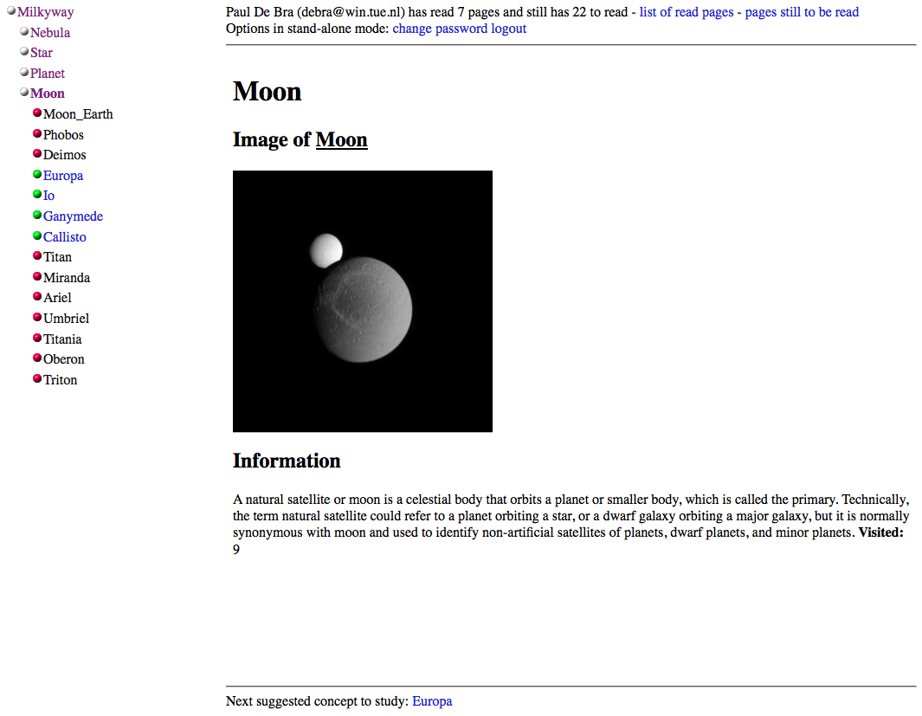
Notes:
When we visit the topic Moon we see something peculiar: Some moons are listed with a green ball and blue link, the other moons have a red ball and a black link.
What is going on is that this course uses rules that consider moons suitable for study only after the planet they orbit around has been studied. As we have only studied Jupiter the moons of Jupiter are considered suitable study material but the other moons are not.
Also note that the “Next suggested concept to study” is Europa, the first listed moon of Jupiter, and the first suitable child-concept of Moon.
Finally we note that the “Moon” page looks similar to the “Jupiter” page, and in fact all the pages of this course look similar, with a consistent layout.
Let us now see how GRAPPLE achieves this type of advice, and more.

Slide 11
Creating Adaptive Courses
Creating conceptual adaptation models
  using authoring tools
  understanding prerequisites
Creating content (pages) for GALE
  using templates and layout definitions
  user model operations within pages
Setting up the GRAPPLE infrastructure
  combining an LMS with GALE
  exchanging user model information
Notes:
So what does it really take to create an adaptive course text?
You need to create a Conceptual Adaptation Model, which is what Jonathan Foss will be explaining. For that you need to understand the meaning of different types of pedagogical relationships, most importantly of prerequisites.
You need to create content. You can create HTML pages, essentially using any HTML editor or generator. The pages can be stored on any web server. This does not require any knowledge of GALE code syntax as the pages need not contain any GALE code. We have created adaptive course examples using pages from Wikipedia for instance.
It is generally better to use templates, as we shall show.
You need to have access to a GRAPPLE infrastructure, including an LMS and GALE. As an author you will typically use an infrastructure that your institute or company will set up for you. You will know a bit about it in order to know how the user model information is stored in GUMF and how it can be retrieved for use in adaptation.

Slide 12
The GRAPPLE Course Model
A course consists of concepts and relationships
A concept has
  properties: value given by the author
  attributes: (generated by the authoring tool)
    value determined by adaptation rules;
    properties, includes data type, persistence, …
    event code: what to do when the value changes
  resources:
    URL to locate the file
    properties can be used to select between resources
  event code: (code on access, also generated)
Notes:
A course in GRAPPLE is represented by a course model. In GRAPPLE every course consists of concepts and relationships.
Every concept has a structure consisting of Domain information, created by the author, User Model information, updated for every user while studying the course, resource information and adaptation rules.
When you create a course you define a structure of concepts and relationships through the authoring tools (as will be shown later, by Jonathan Foss).
The structure of a concept in GALE contains properties that are defined by the author using the authoring tool. In our Milkyway example for instance there is a “title” property with the name of the planet or moon, an “image” property with the URL of the photo, an “info” property with the URL of the textual description of the planet or moon and an “order” property that is used to determine the order of the planets and moons in the menu.
Each concept has user model attributes, with values that are updated as the learner accesses the concept. The attributes may also have properties, such as a data type and an indication whether the value is persistent or not. The attributes have event code to determine the attribute value and updates. An author does not write this event code manually but it is generated through the authoring tools (as Jonathan Foss will show later).
Each concept has a resource. This can be a URL in case the concept always shows the same page, but it can also be a piece of code to select a URL from a list or to compute the URL of the resource to be shown.
Each concept also has event code that is executed when the concept is accessed. The code may for instance increate the knowledge attribute of the concept, and increment a visited counter. Again the author does not write the code. It is generated by the authoring tool.
On the next slides we will show screen shots of the most common authoring process steps.

Slide 13
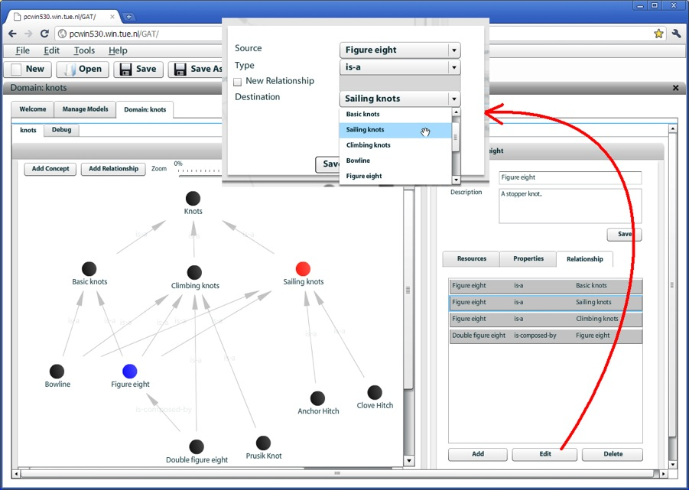
Notes:
This slide shows the first authoring tool: the Domain Tool.
In this tool you create a conceptual structure of the topic domain of a course. You create concepts, with properties and resources and you create relationships between concepts. The structure you obtain is something you could roughly compare with an ontology (but a very simple one).
Typically the structure includes a hierarchy of concepts connected through parent relationships. That hierarchy is used to generate the accordion menu we saw before.

Slide 14
Pedagogical Relationship Types
PRTs define pedagogical relationships between (sets of) concepts:
  can be directed or undirected (this is mainly a visualization aspect)
  can have one or more sockets
  each socket is a placeholder for a set of concepts
  a PRT has template adaptation rule code
  a PRT defines which user model attributes the concepts in each socket must have
Notes:
A GRAPPLE Pedagogical Relationship Type is unlike a DM relationship type. It defines adaptation behavior, by means of template pieces of code, written in the “GRAPPLE Adaptation Language”, used by the GRAPPLE Adaptive Learning Environment GALE.
A PRT can be something simple like a relationship that expresses that some concept must be studied before some other concept: a prerequisite. This would be a directed binary relationship. However, the source and target sockets may contain more than one concept. So the prerequisite PRT can be used to express that a number of source concepts should be studied before going to any of a number of target concepts.
PRTs between more than two sets of concepts are rare but possible. Unary PRTs are much more common, for instance to say that when a concept is visited the user gains knowledge about that concept. This would be a knowledge update PRT.
A PRT also defines which user model attributes each concept of each socket should have. These attributes are used in the adaptation rule code.
A PRT can also be used just to define a user model attribute, without requiring the use of any adaptation code.
It is important to note that PRTs are not intended to define a “learning sequence”. In GRAPPLE we explicitly wish to support adaptive hypermedia where the learner has a lot of navigation freedom. PRTs such as prerequisites are only used to give some advise as to what to study before what else.
We will not study how to create a PRT but we study how PRTs are used to create a Course Model.

Slide 15
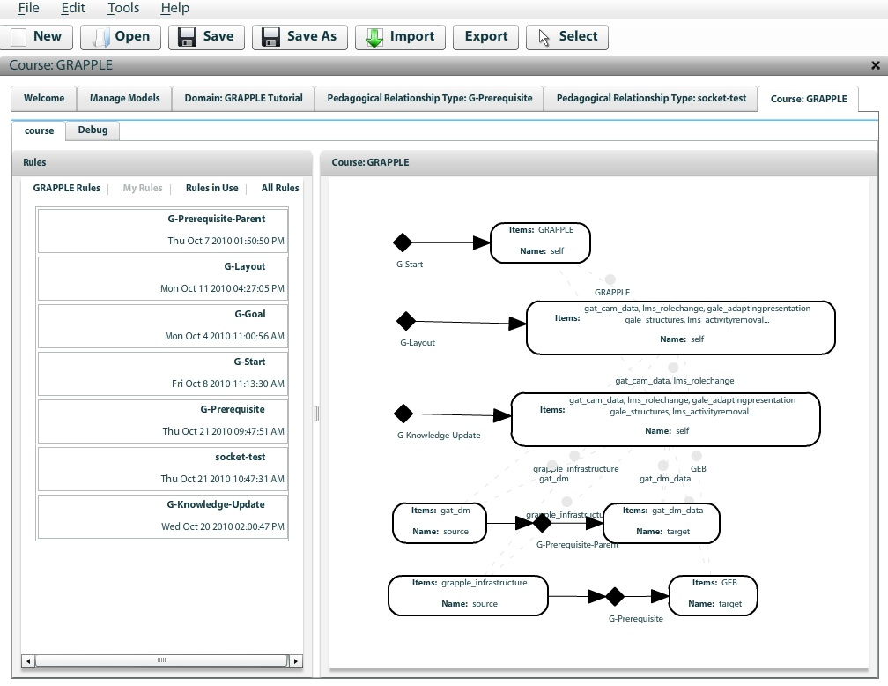
Notes:
The Course tool shows a number of available PRTs on the left and these can be dragged to the drawing pane on the right to create instances of the PRTs in the actual Course Model.
Each instance of a PRT, meaning each unary or binary PRT you see in the graph, defines user model and/or adaptive behavior for the concepts in the sockets of the PRT instance. Some examples from a course called “GRAPPLE” which is actually the GRAPPLE Tutorial:
The G-Start PRT has one socket with one item: the GRAPPLE concept which is the first concept every visitor to the GRAPPLE Tutorial sees. What this PRT does is add a “start” attribute to the concept (with value “true”). This attribute is used by the adaptation engine to produce a URL to the start concept of the course. (The engine can produce a list of courses which is actually a list of URLs to start concepts of the courses.)
The G-Layout PRT has one socket in which in this example we placed all the concepts from the course. This PRT adds a “layout” attribute to each concept with a default value that defines the layout with the header, footer, menu and content parts. You can define different layouts to have different parts of a course presented in a different way, and you can even have adaptation rules that alter the layout sometime during the study of the course.
The G-Knowledge-Update PRT is also applied to all the concepts. What this PRT does is to add event code to the concept to increase the value of an attribute knowledge when the concept is accessed. Likewise we can use a G-Knowledge-Propagation PRT that increases the knowledge value of the parent concept when the knowledge of a concept changes. That PRT has event code associated with the knowledge attribute, not with the concept itself.
The G-Prerequisite PRT states that the “target” concept becomes suitable when the learner has enough knowledge about all the “source” concepts.
The G-Prerequisite-Parent PRT does the same but is used when the “source” concept is the parent of the “target” concepts. It means the same but has different adaptation code and therefore it is a separate PRT.
Note that we do not “draw” a sequence from the start concept, through a series of prerequisites, as in GRAPPLE we don’t do sequencing (although of course you can).

Slide 16
The GRAPPLE Adaptation Engine
Concept access ➔
  user model updates (execute event code)
  determine adaptive layout
  retrieve and adapt a “page” (xml file)
    conditional inclusion of fragments/objects
    adapt destination+presentation of links
  generate additional parts: header, footer, accordion menu, …
Notes:
Before we look in detail at the architecture of GALE we consider the main parts of the functionality. GALE works as a web server so it reacts to HTTP requests. In GALE all requests refer to what we call a concept. These concepts are defined by the author of the course and define the structure of the course domain.
When the learner accesses a concept, typically by clicking on a link.
Each action of the learner triggers event code, called Event-Condition-Action rules, that are used to update the learner’s user model. There is a detailed user model within GALE, used for the generation and adaptation of pages. Some rules may also define updates to user model variables stored in GUMF, the GRAPPLE User Model Framework. The user model in GUMF is typically less detailed than the user model in GALE.
After the user model updates GALE starts preparing the presentation, the response to the HTTP request. The first thing is that GALE constructs a layout for the presentation. Like everything in GALE the layout is adaptive, meaning that the layout might actually be different under different circumstances, like when a different device is used.
A page is retrieved. This can be any xml file but typically it will be xhtml. Several pages may be associated with a single concept. Again based on the user model one page is chosen. The page may contain fragments or references to objects that are conditionally included, based on values in the user model. Both the destination of links and their presentation can be adapted based on the user model. So when different learners see the same page it may actually show different fragments and when they see the same link it may have a different color, perhaps also a different icon around it, and it may not lead to the same destination.
Finally, the other placeholders in the layout are filled in. In our example we see a header, footer and an accordion menu on the left. GALE comes standard with some so called “views” that generate a fragments of xhtml based on the user model and the course. The menu is not the only generated part. The “next” link has a destination that is the first unvisited suitable concept.

Slide 17
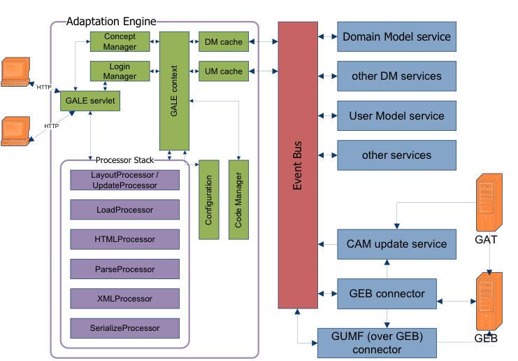
Notes:
This image shows the overall architecture of GALE. We will not study this in detail
In the following slides we look at one important detail: the XMLProcessor.

Slide 18
Creating Content for GALE
Content = nodes (pages) in XML
  standard HTML and XHTML can be used
  special “gale” tags for adaptation:
    <if> <then> <else> for conditional inclusion
    <object> for adaptive resource inclusion
    <a> for adaptive link annotation
    <variable> and <attr-variable> for inserting user model data (in body or within a tag)
    <for> for repetitive insertion (through relationships)
Notes:
The GRAPPLE Adaptive Learning Environment can adapt any type of information, but the XMLprocessor is standard and adapts XML files, which in hypermedia terms are called nodes or pages.
You can use standard HTML which is then first converted to XHTML. We recommend that pages be written in XHTML to begin with.
Adaptation to the content is done through special “gale” XML tags, which are tags within the “gale” namespace.
The <if> <then> <else> tags are used to conditionally include a fragment of the XML file in the presentation. Note that the fragment to be included must be a valid XML fragment.
The <object> tag is used to include a file. The object is typically addressed using a concept and then the properties of the resources of the concept are used to adaptively choose between different files to be included.
The <a> tag is used to perform link adaptation. Depending on the user model the link anchor is shown in a different color and optionally some icons may be shown as well.
The <variable> tag is used to insert information from the course model or the user model in the text. This is how the Milkyway header shows the learner’s name and email address. When the information needs to be inserted not in the text but inside an XML tag you must use the <attr-variable> tag. It’s just a technical difference caused by a restriction in XML that inside an XML tag (not the element but the tag itself) you cannot use a nested XML tag. <variable> was used in the Milkyway example to show how often a page was visited.
The <for> tag is used to repeat a fragment for every concept in a list. This was used in the Milkyway example to generate the list of moons of Jupiter. Any XML fragment can be repeated. We used a bullet list with links to the moons, but that was just an example.

Slide 19
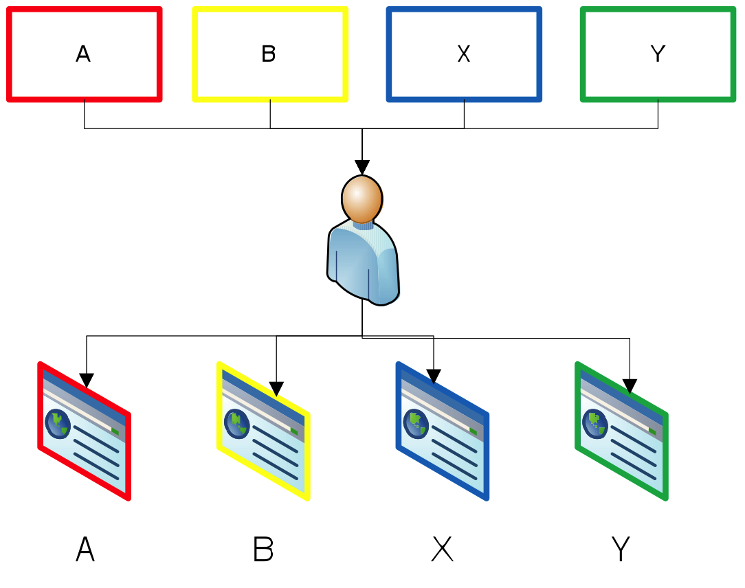
Authoring Pages Separately
Notes:
The easiest way to write an adaptive course is to write all the pages separately. For every concept a page is designed completely by hand. This allows for infinite creativity but unfortunately if most pages look the same they all share a template-like piece of HTML code that is copied many times. Any change to the design requires major effort.
In the example here pages A and B are very similar and X and Y are very similar.
Any change in the presentation style of pages A and B needs to be done twice, and the same for X and Y.

Slide 20
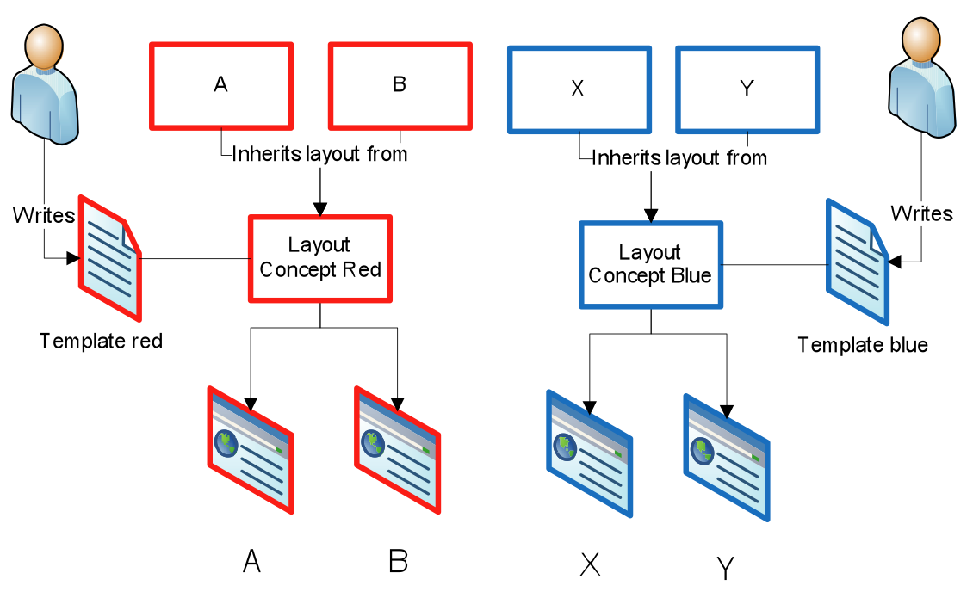
Template-Based Authoring
Notes:
We therefore recommend the use of template pages, with placeholders for content. The Milkyway example was created this way. The name of a planet, the URL for its image and information fragment, the list of moons, all of this was filled in on the fly by the adaptation engine. The page only has placeholders that refer to the Course Model. So the many pages that look similar do not look similar by accident. They are actually the same page with content inserted through object inclusion.
If you now want to change the presentation of all pages you only change one or a few templates.

Slide 21
Conditional Inclusion of Fragments
Example from the course “hypermedia structures and systems” taught at the TU/e:
  Before reading about Xanadu the URL page shows:
    …
    In Xanadu (a fully distributed hypertext system, developed by Ted Nelson at Brown University, from 1965 on) there was only one protocol, so that part could be missing.
    …
  After reading about Xanadu this becomes:
    …
    In Xanadu there was only one protocol, so that part could be missing.
    …
Notes:
In this example we use the conditional inclusion of fragments adaptation technique. The example is from an actual page in the course “Hypermedia Structures and Systems” that we teach entirely on-line at the TU/e.
For this example we use two concepts: URL and Xanadu. The excerpt is taken from the page on URL. On this page we refer to the concept Xanadu. We do this through a link and a short explanation. The short explanation on Xanadu is only interesting for learners who have not yet studied the Xanadu concept. So it is only shown to these learners and not to learners who already know about Xanadu.
Note that when a learner sees the first version of the URL page, with the explanation, then clicks on Xanadu to study it and then comes back to the URL page, the learner will then see the second version. Despite this apparent difference, no student has ever come forward with a message that “something was changing on me”. As an author you should use conditional fragments with care as content that changes when you revisit a concept may be distracting or even disturbing.

Slide 22
Link Adaptation in GALE
Standard schema:
  links are good, neutral or bad;
  link classes are used by a CSS stylesheet to create the presentation color scheme
Actual functionality:
  any expression to define the link classes
  (${#suitability}?(${#visited}>0?\"neutral\":\"good\"):\"bad\")
  any expression to choose the stylesheet
  any expression to choose icons
Notes:
The link adaptation in GALE mainly consists of playing with the color of link anchors. The way GALE plays with the colors is as follows:
Based on some expression over the course and user model a string is chosen, which becomes the class of the link anchor. GALE comes with a standard/default scheme that has three link classes: good, neutral and bad.
When links are presented a stylesheet is used to select how a link of a certain class is presented. GALE comes with a standard/default stylesheet that gives the good links the color blue, neutral links purple and bad links black. This results in the blue and purple links we know as the standard browser link colors, and black which becomes indistinguishable from the black text on a webpage. Bad links, shown as black text, are effectively hidden when used in a page, but of course not hidden when used in a menu as we saw in the Milkyway example.
If you do not like this color scheme, how can you change it?
Any expression can be used to choose between as many link classes as you want. The default expression is (${#suitability}?(${#visited}>0?\"neutral\":\"good\"):\"bad\") which Java experts will immediately recognize as an expression that uses the class “neutral” for suitable and visited concepts, “good” for suitable and unvisited concepts, and “bad” for unsuitable concepts.
Any expression can be used to choose the stylesheet. Typically a single stylesheet will be used for a whole course.
Any expression can be used to choose icons to be presented either before or after the link anchor.

Slide 23
Life-long Learning in GRAPPLE
Learners move during their life time: different companies and institutes
  Learner information (user model) must be stored independently of the LMS+ALE
  Different LMSs and ALEs must be able to communicate with each other
  Learners should have a single identity everywhere
Notes:
GRAPPLE aims at life-long learning. This means that it must support learners in their learning throughout all the moves they make in their life. We don’t want an Adaptive Learning Environment to have the cold start problem each time the learner moves. Three things must be realized to support life-long learning:
The learner information or user model must be independent from the specific LMS or ALE that is used. In GRAPPLE we developed the GRAPPLE User Modeling Framework GUMF as a distributed user model storage, retrieval and reasoning framework. Each LMS and also GALE still have internal user models but they should communicate the essence to GUMF.
In order for LMSs and ALEs to work together and to communicate with GUMF there should be a common communication channel. Within GRAPPLE we developed the asynchronous communication bus GEB to facilitate this communication.
The schema with LMS, GALE and GUMF only works well if users can be identified in a unique way. GRAPPLE relies on Shibboleth to provide a single sign-on facility for learners.
These three requirements result in the architecture that is shown on the next slide.

Slide 24
Notes:
This final slide shows the architecture of GRAPPLE. It shows the LMS, GALE and GUMF parts, connected through the event bus GEB and the single sign-on facility Shibboleth.
(The careful observer will notice that GUMF is not connected to Shibboleth: users are identified for the LMS and GALE and GUMF then automatically gets that user id in the user model updates it processes.)
We also see some additional components like GVIS for the visualization of user model data and GAT which is the authoring tool.
This is all we have time for, so now on to the questions…

