Slide 1
A Fully Generic Approach for
Realizing the Adaptive Web
Prof. dr. Paul De Bra
Ir. David Smits

Slide 2
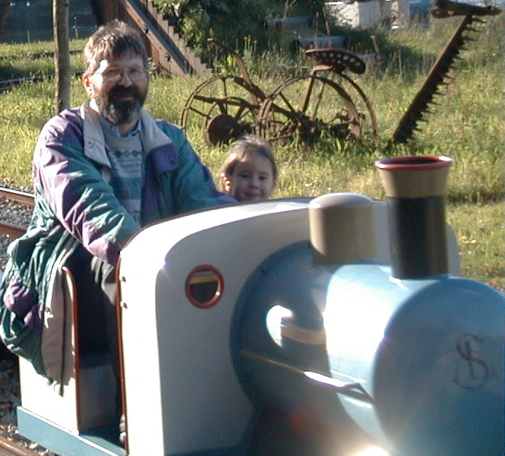
We live in a “one size fits all” world
What’s wrong with this picture?
Where else do we see the same problem?
What is a common way to overcome this problem?
Notes:
The picture we show here is of the pedal trains in the Efteling (a family amusement park in the Netherlands, one of the best in Europe). The problem with these pedal trains is that small children cannot reach the pedals, so they need to be accompanied by an adult, but an adult does not fit in the seat.
In the physical world we often encounter such things that do not fit. This holds for one size fits all garments like a hotel bathrobe or other items in the physical world that are constructed for the average person.
Want more examples? Just look around you, to discover that tables, chairs, light switches, door handles, bathroom sinks, etc. have a standard height. And when something does not have that height we find it odd (like the light switches in some houses or offices). But there exists no average person in our society. We experience that doorknobs and light switches are either too high or too low. Car seats are always too far forward or backward. The mirrors always need adjusting. Lots of things can be adjusted because they are not positioned correctly for us by default. When some aspect of a system can be adjusted to suit our needs we call it an adaptable system. Making things adaptable is the most common way to overcome the “one size does not fit all” problem.
Another approach to overcoming this problem is to offer alternatives or choice. There are different newspapers, several TV channels, several flavors of lemonade and jam, because people have different taste or different information needs.
In this course we go one step further: we want systems that offer choice and that also automatically adapt themselves to their user or to the environment in which they are used. A system that automatically adapts is what we call an adaptive system. Do we know a common example of an adaptive system? Yes we do: the human.
The human is very good at adapting to his or her environment. We have learned to use non-adaptive systems by adapting ourselves. We can actually use the most unusable systems because we are so good at adaptation.
But in this course we study systems that work the other way around: they do not require the human user to adapt but they adapt themselves.

Slide 3
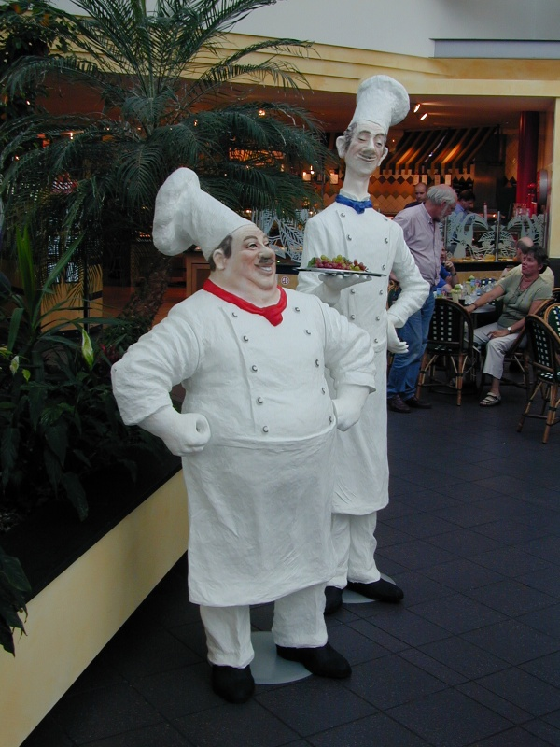
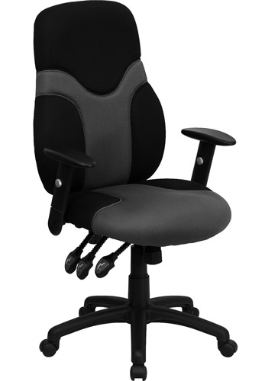
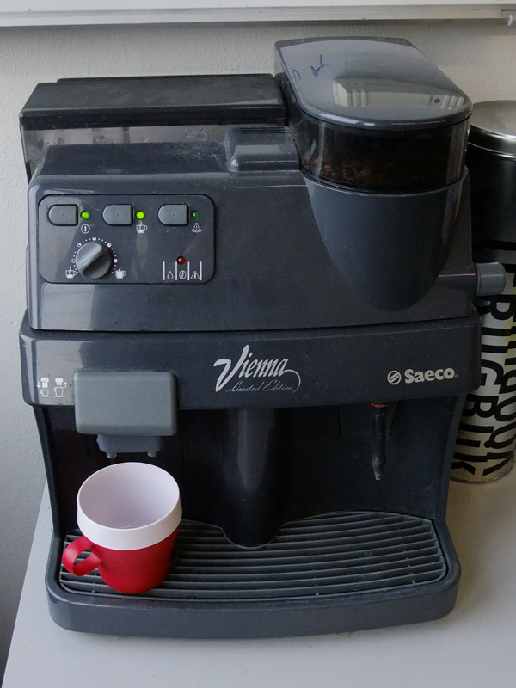
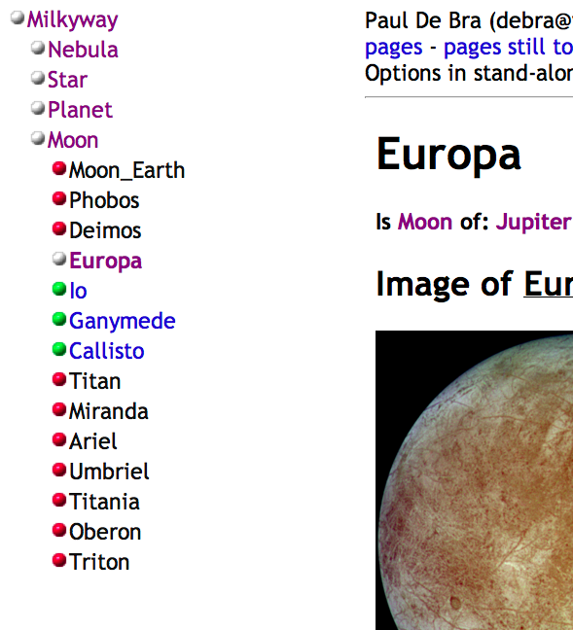
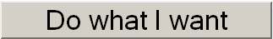
Levels of Personalization and Adaptation
customization: different sizes, different options
adaptability: make in one size but with adjustable settings
responsive: “automatic” response to commands
adaptive: rules define how the system responds under different circumstances
intuitive: optimal behavior
of system is self-learned
Notes:
The examples we have seen clearly lack “personalization”. Let us now look at the different levels of personalization that we might wish for, and then we will see what we can realize with technology…
The first approach to personalization solved what is obviously wrong in the examples we gave: “one size fits all”. Industry has solved this by producing products in different sizes, and by offering different options. Cars are a good example of a product with many options to suit the desires of the customer.
The second approach is to put some of the personalization in the hands of the user by making a product adaptable or adjustable. The image shows a desk chair with many adjustable settings. You can change the shape and position of the chair in many ways (and it will still not feel right).
The next step is to automate the response to commands. The end-user tells the system what to do, not how to do it. The system responds to requests in a fixed programmed way. The picture shows my coffee maker, with one adjustable setting, and one button to fully automatically have it brew one cup of coffee.
An adaptive system changes its own behavior based on “circumstances”, like e.g. a history of what the user has done before, or other circumstances, like for instance a room thermostat that learns how the heating system works and optimizes the behavior.
The final level of personalization is a system that learns how to adapt to its users or the environment all by itself. Obviously, we have not yet reached this level of intuition and intelligence in adaptive systems. So in this talk we will mainly discuss how to create systems of the “adaptive” type, with “adaptation rules”.

Slide 4
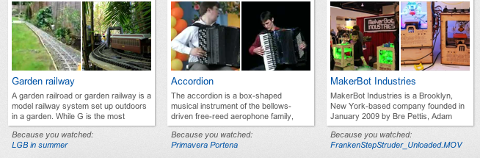
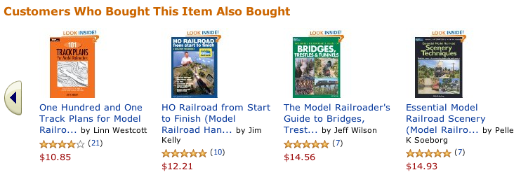
Adaptive Web-based Applications
Some popular examples:
Notes:
Adaptation in Web-Based applications often take on the form of recommendations.
The first example shows recommendations from YouTube. They appear to be based on tags associated with items. I have watched videos about garden railways, accordion and 3D printing and YouTube recommends a video from each of these categories (at least they are categories in my mind, but who knows how YouTube has actually modeled the world). YouTube at least does not suggest that the recommendations are based on something that other users have done.
The second example is from Amazon and shows collaborative filtering: Amazon does not claim that the recommendations would be based on any semantic metadata associated with the items but claims that the recommendations are based on what other people have bought.

Slide 5
A Generalization of Web-based Adaptation
A generic view on Web-based adaptation:
  items may have associated semantic metadata
  (in general this can be of any form)
  the system records actions of users
  the system may draw conclusions from these actions
  (it may e.g. conclude that the user is interested in being recommended something “similar”)
  these conclusions may be associated with the user or with other users
  the system uses some rules to give a recommendation based on these conclusions
Notes:
From just these two examples we can already build a generic view of what Web-based adaptive applications need to do or can optionally do:
Items may or may not have associated semantic metadata. Some systems seem to use this (YouTube) and other systems seem not to use this (Amazon) but it is not always observable what goes on inside the system.
Every adaptive system records the actions of users. It may record more things, like observations of the context in which an action takes place, considering things like time and place, equipment that was used (computer or phone), etc.
The system draws conclusions from the users’ actions, which we often call a user model. Watching some videos on YouTube may lead the system to believe that you are interested in the topics or tags associated with these videos. The system may decide to keep a log of the actions, but may also decide to only keep that higher level representation in the form of the user model.
Some systems clearly use what they know about a user in the conclusions it draws for other users. The behavior of a user has influence on what other users see. Other systems do not use such information as clearly, and we may even have systems that explicitly guarantee that a user’s information is not having any effect on what others see, in order to guarantee privacy.
Every adaptive system follows some reasoning or rules in order to give personalized recommendations based on the user model, based on what it has concluded from this user’s past behavior and possibly also the behavior of others.

Slide 6
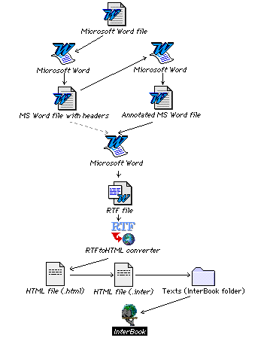
Abbreviated history: 1) Interbook
Interbook (Brusilovsky):
  author writes textbook in MS Word
  comments are used for background concepts and outcome concepts
  compiler translates (rtf) to HTML files (one per concept)
  Interbook then provides adaptive link annotation
  What is not such a good idea here?
  Answer: mixing content with adaptation rules
Notes:
We give a very incomplete quite overview of some of the historical events in the development of adaptive systems.
We start with Interbook, a system designed by Peter Brusilovsky, for the adaptive delivery of textbooks. This system was developed in the mid nineties.
To make Interbook easily accessible and usable by non-technical authors it uses MS Word (some may find this ironic or hard to believe…)
Word is mainly used to write the contents of a textbook, but the ability to add comments to a Word document is used to define background concepts or prerequisites and outcome concepts, i.e. concepts the learner will learn something about when studying a part of the textbook. The comments are placed at the beginning of sections and apply only to that section.
The Word document must first be saved in RTF (Rich Text Format). This was done because the Word format was not well-defined and RTF was. The RTF file is then compiled into a set of HTML files, one for each section.
These HTML files are served by Interbook, on a Lisp-based Web server. We show what an Interbook web page looks like on the next slide. The main adaptation provided by Interbook is adaptive link annotation. Learners get advice as to which links to sections are recommended and which are not.
Something is not quite “right” with the overall approach taken by Interbook, for authoring adaptive textbooks. What is it?
The answer is: content (learning material) and the pedagogy regarding how to learn that content is mixed within a single source file. So Interbook does not satisfy common rules about separation of concerns.

Slide 7
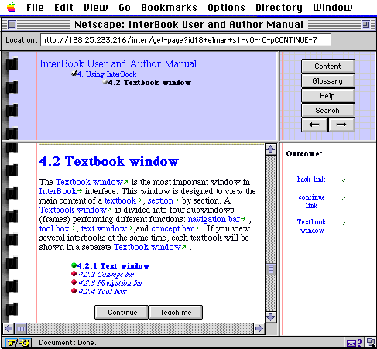
Interbook example page
Notes:
Here is an example of a page from an Interbook course. At the top we see a part of the concept hierarchy (the hierarchy of sections and subsections), in the text we see more links and we see the link annotations with colored balls, checkmarks and arrows.
The colored balls follow the so called “traffic light metaphor” (green = go, red = stop).
On the right we see a list of outcome concepts this page teaches you something about. A checkmark indicates how much you know about each concept.
Note that all Interbook applications have exactly the same look and feel: the same layout, the same type of link annotation, etc.

Slide 8
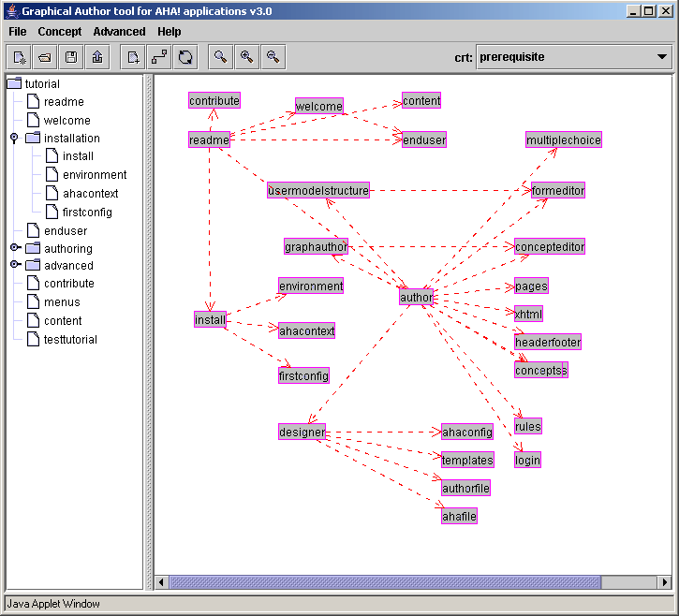
Abbreviated history: 2) AHA!
AHA! = the Adaptive Hypermedia Architecture
  Graph Author to
  define concept-
  ual structures
  hierarchy of
  concepts
  arbitrary graph
  of arbitrarily
  typed concept-
  relationships
  pages written in
  “plain” HTML
  layout defined
  separately
Notes:
Independent of Interbook, developed in Pittsburgh we developed AHA! in Eindhoven, with some sponsorship from the NLnet Foundation.
AHA! stands for Adaptive Hypermedia Architecture. The main thing it did differently from Interbook was the issue of separation of concerns:
First of all AHA! has a special graphical editor for defining the conceptual structures, separate from the content.
On the left in the Graph Author we see a hierarchy of concepts, corresponding to a domain model with the hierarchy of sections and subsections typically found in a textbook.
On the right we see an arbitrary graph of arbitrary relationships between concepts. The author can define any number of types of such relationships, and define adaptation code for them. In the graph each type of relationship is presented using a different arrow style. The example graph shows a structure of prerequisite relationships.
The content of an application for AHA! consists of HTML pages. In later versions this became XHTML, with some special tags to allow for the conditional inclusion of fragments.
The HTML pages only define the main content of the page to be presented. Layout, such as the “navigation menu” we saw in Interbook, is defined separately. AHA! applications can thus all have a different look and feel. Next we show two examples.

Slide 9
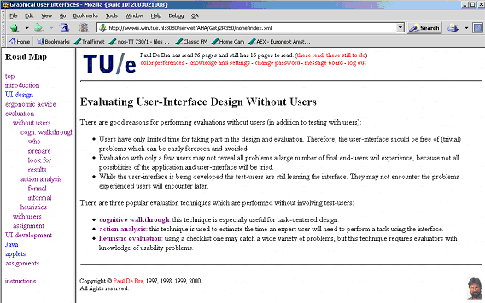
Example AHA! page
AHA! does not have a standard layout, but most existing AHA! applications look like this:
Notes:
Many people know AHA! only from the presentation style used in this (not so good) screen dump. Each page is presented with a navigation menu on the left, a header at the top and a footer with copyright statement. However, none of this is determined by the AHA! system. It’s all in a definition of layout (and of the content of the header and footer).

Slide 10
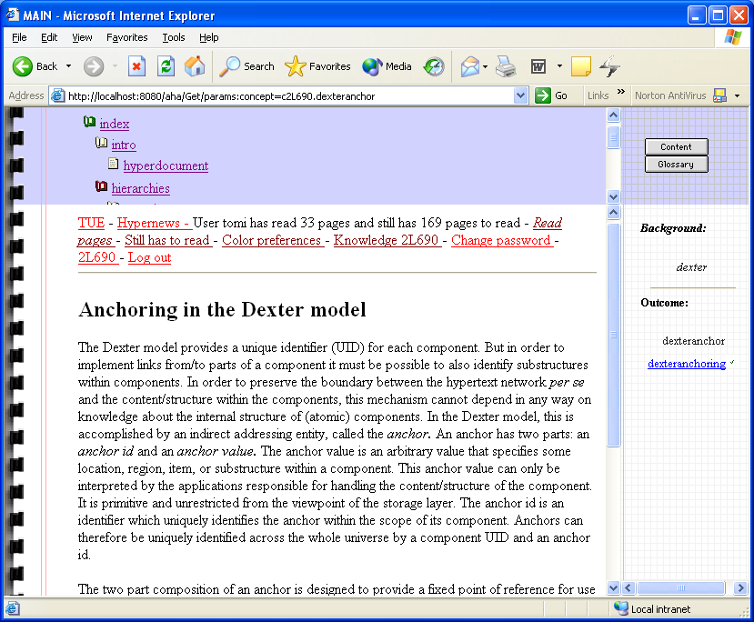
zz
Notes:
This screendump may (at first glance) look like it’s a page from an Interbook course. However, this is wrong. This is a page generated by AHA!, using a layout definition that mimics the Interbook style. It was developed in a joint project between Pittsburgh and Eindhoven.

Slide 11
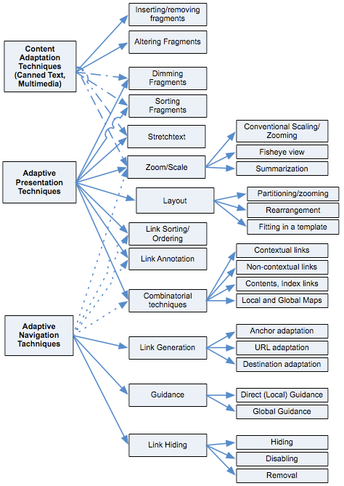
Intermezzo
taxonomy of
adaptation techniques
(Knutov et al, 2009)
note: does not cover
user modeling or
adaptation decisions
Notes:
We show the latest taxonomy of adaptation techniques, developed by Evgeny Knutov, PhD student at the TU/e.
This shows the many techniques that are being used in adaptive Web-based systems.
Note that the taxonomy only shows the adaptation techniques, not the user modeling techniques or the decision procedures when to apply which technique.

Slide 12
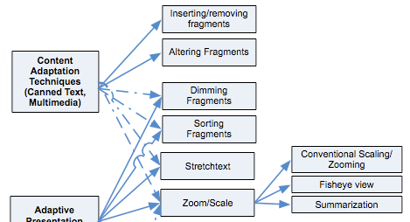
Content Adaptation
Notes:
This part of the diagram shows pure and partial forms of content adaptation.
They are mostly used for canned text adaptation, but they could be generalized to other media besides text, and some could also be combined with natural language adaptation.

Slide 13
Example of inserting/removing fragments, course “2L690”
Before reading about Xanadu the URL page shows:
  …
  In Xanadu (a fully distributed hypertext system, developed by Ted Nelson at Brown University, from 1965 on) there was only one protocol, so that part could be missing.
  …
After reading about Xanadu this becomes:
  …
  In Xanadu there was only one protocol, so that part could be missing.
  …
Notes:
In this and the following slides we give a few random examples of content adaptation. The course “2L690” was initially “2L670” and is now “2ID65”, but still contains the same example.
This example shows a prerequisite explanation in our hypermedia course. The course contains several of these conditionally included fragments. In general users may find it disturbing when the same page does not always contain the same contents. However, in the hypermedia course the changes are so subtle that until now no one has complained about the content adaptation.

Slide 14
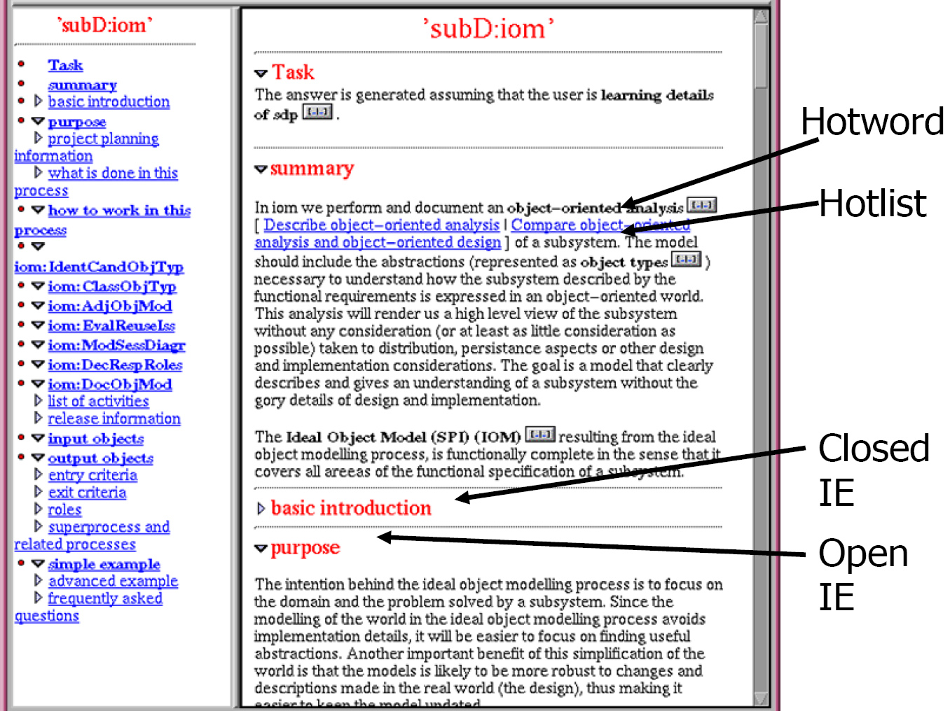
Stretchtext example: the Push system
Notes:
Opening and closing sections in Push results in user model updates indicating a change in interest. This influences which paragraphs will open and close when the next page is requested.

Slide 15
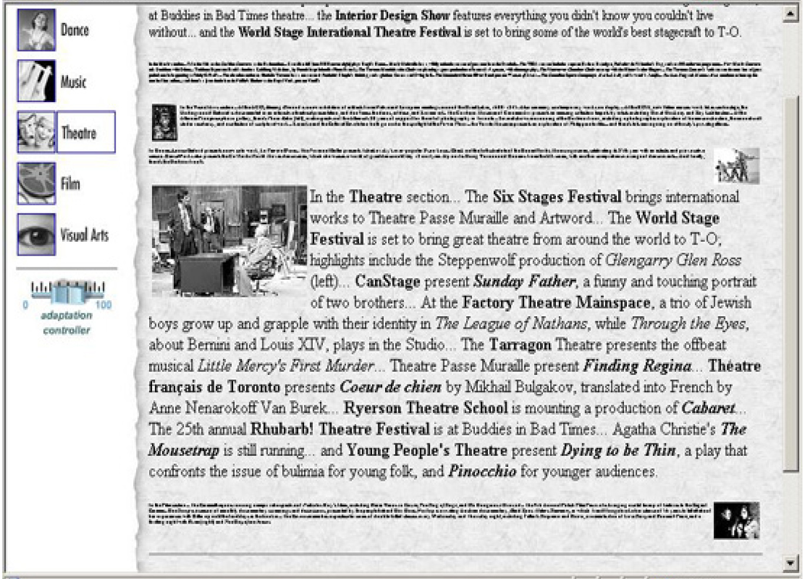
Scaling-based Adaptation
Notes:
Scaling as shown here still gives access to all information. It has been taken to the extreme in the sense that you really need to expand the scaled sections in order to read them.
It is thus a relative of stretchtext but gives you just a bit more information to go on in order to decide whether you want to open an item or not.

Slide 16

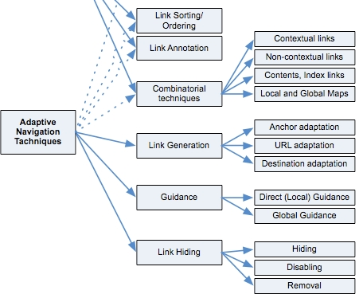
Adaptive Navigation Support
Notes:
This is the bottom part of Knutov’s taxonomy. It shows the different ways in which the links or link structure can be adapted.
We will also describe each of these in detail later. We see essentially two different types of adaptation here: guidance, link generation and the combinatorial techniques are techniques to generate links that enable the user to go to places to which there is no link in the “standard” presentation of the page. Adaptive link sorting, hiding it all its forms and annotation, are all ways to manipulate the links that are already present on a page. They influence the navigation by steering the user towards some links and away from other links.

Slide 17
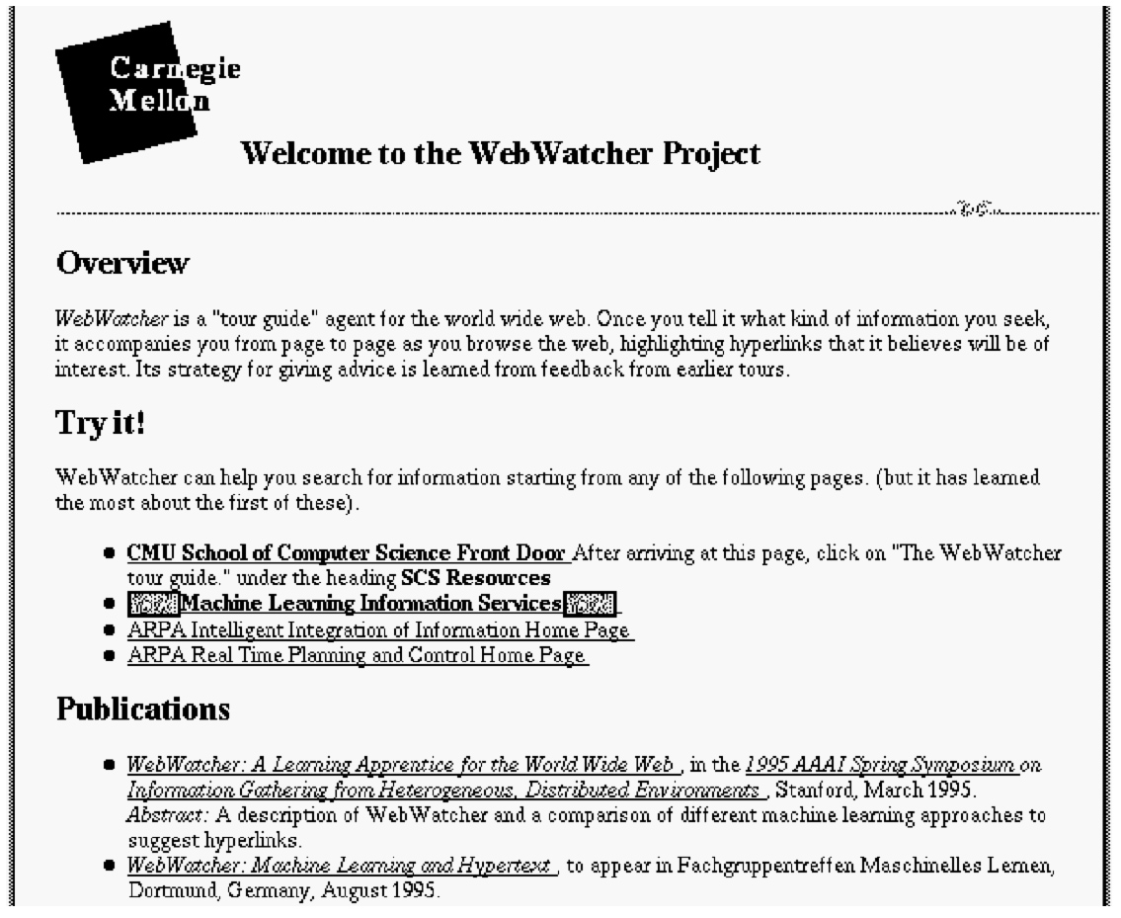
Example of Direct Guidance
Simple: suggest one best page to go to
  Webwatcher:
  curious eyes
  Sometimes a
  “next” button
  Popular in ITS
  (sequencing)

Slide 18
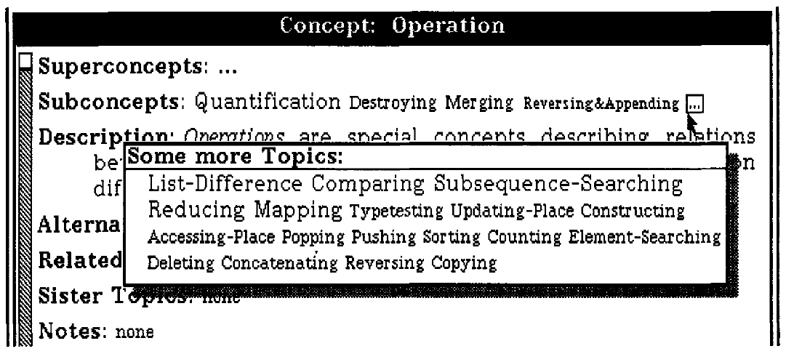
Example: Link Ordering/Sorting
Sorting links from most to least relevant.
  first introduced in Hypadapter (Lisp tutor)
  manual reordering by the user (if supported) can be used as feedback to update the user model
Notes:
The idea of adaptive sorting is to prioritize all the links of a particular page according to the user model.
Many systems employing this technique exist. Hypadapter (see the figure) was the first one we know of.
Newer systems like HYPERFLEX allow the user to move items around (by dragging) to indicate that (s)he does not agree with the suggested order. This feedback can be used to update the user model.
Note that link sorting is different from link generation (which we discuss later) which is what search engines perform.
The example here shows that there are a fixed number of topics to be mentioned (and presented as links) and that fixed list is sorted.
As can be seen Hypadapter not only sorts the links but also uses decreasing font sizes to emphasize the best and deemphasize the worst suggestions.
Obviously, link sorting is something you can only do to a list of links. You cannot use this technique to indicate suitability of links that appear in running text.

Slide 19
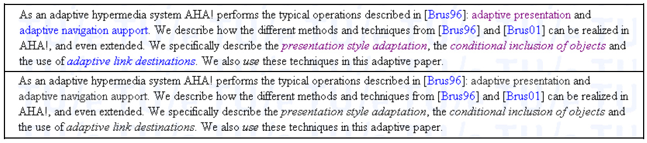
Example of Link Hiding
Example from AHA!: show only most relevant links.
  should be used “unidirectionally”: make more links become available, but never start hiding previously presented links
Notes:
The basic idea behind link hiding is to reduce the complexity of the navigation space by only showing a limited number of links, removing or disabling access to currently not relevant pages.
Through link hiding you can avoid the increasing wikipedia navigation mess where almost every word or phrase on pages is becoming blue. (Check out wikipedia's page on software for instance, and this is most likely not nearly the worst case.) When the whole page turns blue you cannot distinguish the links any more and you have no idea where to go to next.
Link hiding hides the fact that a phrase is a link by not underlining the link and by using the same color as for normal text (typically black). The link is still there and by mousing over it you can see the cursor change shape.
Link removal removes the link anchor. This can only be done in a list of links of course.
Link disabling changes a link anchor into plain text. It is not advisable to keep the (blue) link color, so disabling needs to be combined with hiding.
It can be disturbing when links that the user has seen suddenly disappear. (This is desired in adventure games, but typically not in information services.) So previously hidden links can become visible but visible links should not disappear.

Slide 20
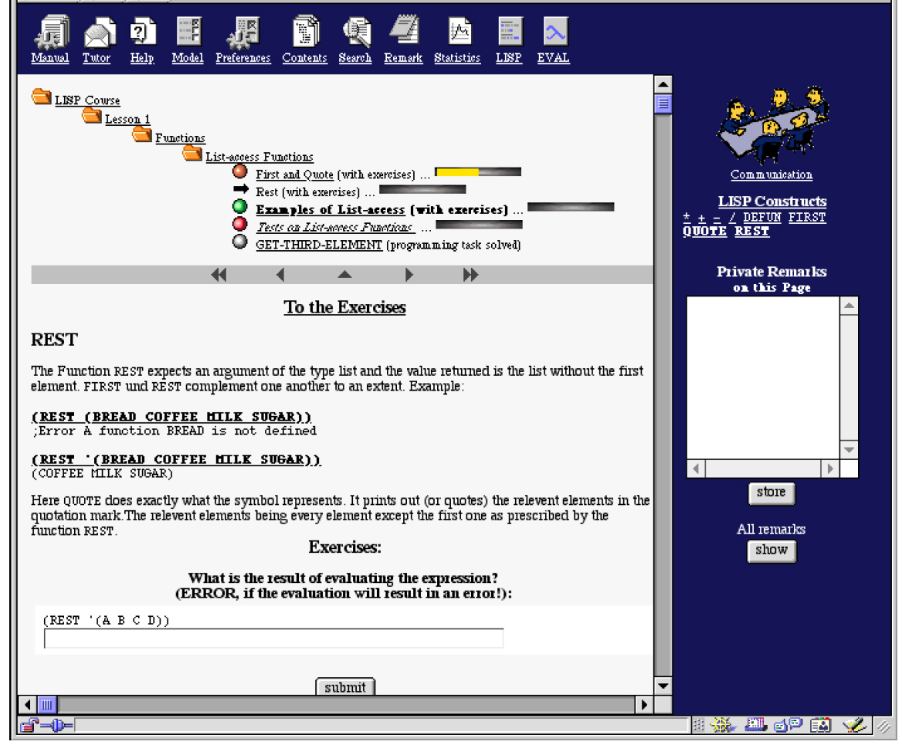
Example: link Annotation in ELM-ART
Notes:
Link annotation is currently the most common technique, and in fact we already saw it to some extent in the previous examples: the “curious eyes” in WebWatcher were link annotations, and so were the font changes in Hypadapter and the blue versus purple links in the link hiding examples of AHA!.
We start with a screendump from ELM-ART, one of the most influencial adaptive educational hypermedia systems ever. ELM-ART is a Lisp tutor (and the system itself is written in Lisp as well).
Link annotation is a term that covers every possible way in which a link (anchor) is augmented with some form of annotation, be it in the form of font, color, additional icons, mouse-over annotations or anything else.
Current systems can distinguish up to 6 states indicated using colors and icons (except for AHA! that can distinguish an unlimited number of states) whereas with link hiding you can only distinguish 2 states (hidden or not hidden).
In ELM-ART we see orange, green, red and white balls, and a black arrow (which indicates where you are). Green is recommende, red is not recommended, white means completely studied, orange is partly done The bar also indicates the progress.

Slide 21
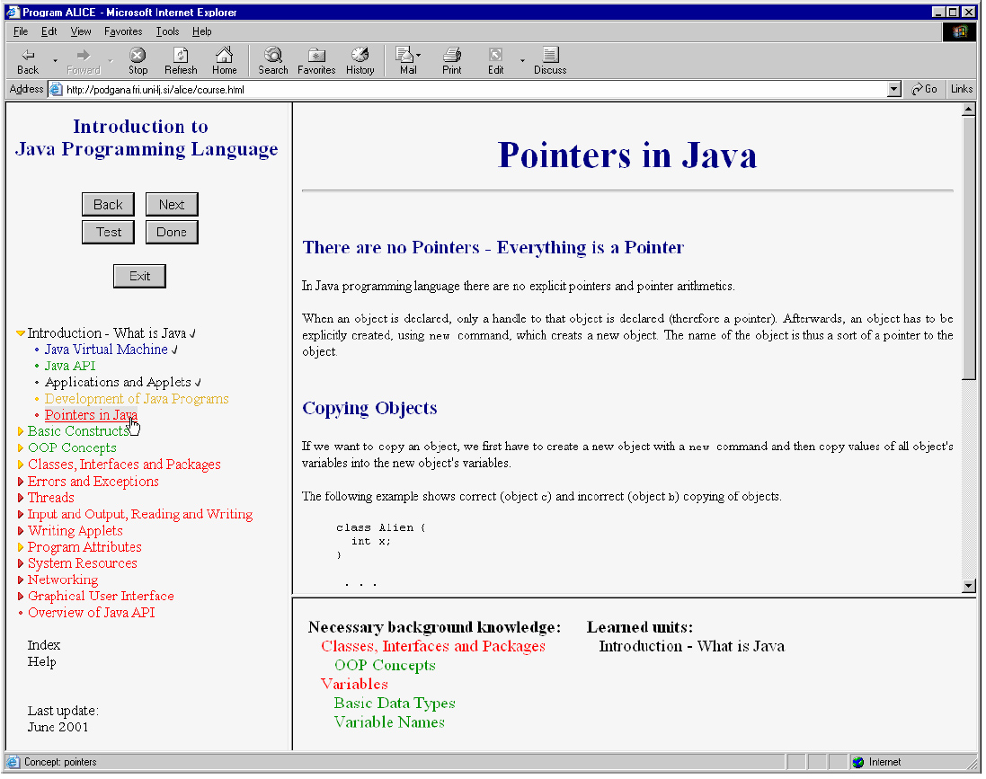
Example: Link Generation in Alice
Notes:
We see here a screenshot from ALICE, an electronic textbook about Java.
Instead of having fixed links that are annotated the main navigation support in ALICE consists of link generation.
The typical green/yellow/red color annotation scheme is used. The section on “Pointers in Java” that is shown was not recommended, and therefore there are also no next sections that are suggested. There is a list of background knowledge that needs to be studied, and this is automatically generated through a structure of prerequisite relationships.

Slide 22
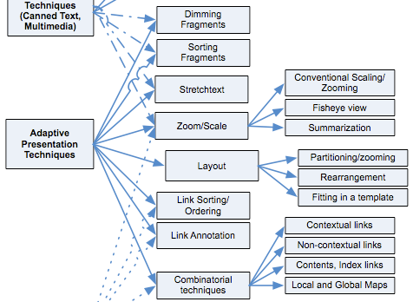
Adaptive Presentation
Notes:
This is the middle part of Knutov’s diagram. Some techniques can change the presentation of an application without strictly speaking changing the content or the possible navigation.
For instance, dimming fragments can be done by changing foreground and background color, leaving the text intact. Stretchtext leaves all the text accessible. Link annotation does not remove the links but only annotates them.
There is one technique that is “pure” adaptive presentation: Layout adaptation, like we showed for AHA!. Note that also layout can be changed on the fly in layout adaptation. AHA! cannot do this, but our new system GALE can.

Slide 23
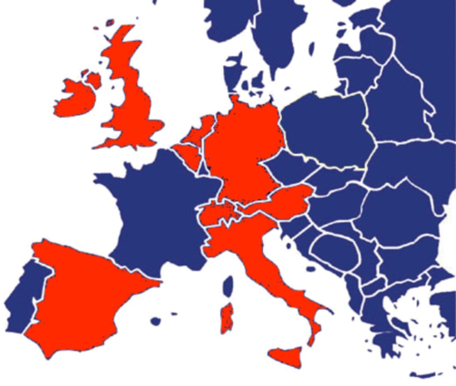
The GRAPPLE Project
EU FP7 STREP Project
  15 partners from 9 countries
  12 education/research, 3 companies
  budget 5.3 M€, subsidy 3.85 M€
  3 year project, Feb. 2008 to Jan. 2011
  main goal: delivering an integration between Learning Management Systems and Adaptive Learning Environments
  main achievements:
    a generic and extensible adaptation engine: GALE
    a generic template-based authoring tool: GAT
    a generic distributed user model framework: GUMF
    linking everything together

Slide 24
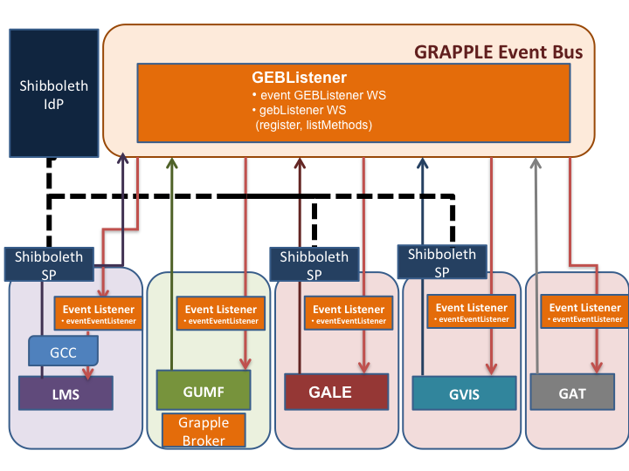
Notes:
This image shows how GRAPPLE realizes the infrastructure to support adaptive learning. Key elements here are:
Shibboleth is used to provide unique user identities: as you move between institutes and companies you remain “yourself”.
All components talk to each other through a common event bus. To add new components like a new LMS to GRAPPLE it needs to learn to speak with “GEB”.
Everything we know about a user (at a sufficiently high level of abstraction) is stored in GUMF, a common user model framework. So when you enroll in a course on some LMS, you take a test on that LMS, this is communicated with GUMF.
The actual adaptive “learning” takes place in GALE. Some actions you do in GALE, for instance completing a chapter of a course, or taking a test in GALE, are also communicated to GUMF. GALE can perform adaptation based on any information stored in GUMF, so a test you take on an LMS may influence the adaptation in GALE.
Then there is GVIS to visualize learning progress for individual learners or groups, and GAT: the authoring tool to define new adaptive courses.
In this tutorial we concentrate on two parts: GAT and GALE

Slide 25
Adaptation (in GRAPPLE and elsewhere)
Information exists
  in concept properties (title, description, fragments)
  in resources (pages, objects, images, …
and can be (conditionally) presented
Links appear in content and can be adapted (annotated, hidden, adaptive destination)
Information and links can be generated through views
Notes:
In order to author adaptation we need to understand what adaptation in GRAPPLE actually means. The earlier slide (7) with the “anything goes” message is too optimistic for what we can achieve during this tutorial, and too ambitious for most authors.
So we will concentrate on what we can do with adaptive content and links.
In GRAPPLE the information that we can show on pages exists in concepts and resources.
We define concepts or topics with certain properties. These properties may actually contain “printable” information that we can show to the user. Think of the “title” used in the Milkyway example.
Most information resides in resources or files. The “page” shown to the user is a resource associated with a concept. It may include other resources, like an “object” with an xml fragment, or an image. The Milkyway example shows a paragraph of text that is included as an “object”, and it shows an image of a planet or moon. The resources can be conditionally shown or hidden.
The links that we see on the page appear in the content and can be adaptively annotated or hidden. Also, the destination of the link may be adaptively computed or chosen from a list.
We also see links in a navigation menu. Such a menu is generated from the conceptual structure of the GRAPPLE application (course). We use views to present generated parts.

Slide 26
From UM updates to Adaptation
Two opposite approaches for adaptation:
forward reasoning:
  register events
  translated events to user model information
  store the user model information
  adaptation based directly on user model information
backward reasoning:
  register events
  store rules to deduce user model information from events
  store rules to deduce adaptation from user model information
  performing adaptation requires backward reasoning: decide which user model information is needed and then deduce which event information is needed for that.
Notes:
Forward and backward reasoning are two common techniques used in the process of collecting information about user actions, processing it into user model information and then using that user model information to perform adaptation.
The difference is first of all in what is stored: more low level information like which events happened, or more high level information like which concepts you know or which art style you like, etc.
Forward reasoning means that you start drawing conclusions from the user's actions, and you store these conclusions, whether this high-level information about the user will ever be needed or not.
Backward reasoning means that you only draw conclusions about the user when you really need it, at the time of deciding on adaptation to be performed.
Can you come up with advantages and drawbacks of both approaches?
Think of storage needs, the time at which the processing is done, privacy/security issues, etc.
In GRAPPLE authoring we use both forward and backward reasoning, but GALE actually simulates backward reasoning through forward reasoning.

Slide 27
When to perform Adaptation?
Two choices:
  Upon concept/page access first perform UM update, second perform adaptation (to the new UM state)
  Upon concept/page access first perform adaptation
  (to the old UM state), second perform UM update
Which choice is best, and why?
Notes:
We have seen that when a user accesses a concept or page two things happen: the user model is updated because the user is learning about the concept, and the page is adapted based on the user model. But what happens first?
We could first perform the user model, and then adapt the page. This would mean that the page is adapted to the new UM state, meaning that the page will be shown like it is shown to learners who already know this concept.
We could also first perform the adaptation, to the old user model state where the learner does not yet know the concept, and then update the user model.
Which of these choices is best, and why?
To understand the “right” answer we may look at mimicking standard browser behavior. When a page contains a link to itself and you visit the page for the first time, is that link shown as blue or purple? The answer is: purple. To achieve this the page must be adapted to the new UM state. Also, suppose page A is a prerequisite for page B and A contains a link to B. Should the link from A to B be “recommended” or not? Answer: it should. This again requires adaptation to the new UM state.

Slide 28
The GRAPPLE Adaptation Engine (GALE)
Concept access ➔
  user model updates (execute event code)
  determine adaptive layout
  retrieve and adapt a “page” (xml file)
    conditional inclusion of fragments/objects
    adapt destination+presentation of links
  generate additional parts: header, footer, accordion menu, …
Notes:
Before we look in detail at the architecture of GALE we consider the main parts of the functionality. GALE works as a web server so it reacts to HTTP requests. In GALE all requests refer to what we call a concept. These concepts are defined by the author of the course and define the structure of the course domain.
When the learner accesses a concept, typically by clicking on a link.
Each action of the learner triggers event code, called Event-Condition-Action rules, that are used to update the learner’s user model. There is a detailed user model within GALE, used for the generation and adaptation of pages. Some rules may also define updates to user model variables stored in GUMF, the GRAPPLE User Model Framework. The user model in GUMF is typically less detailed than the user model in GALE.
After the user model updates GALE starts preparing the presentation, the response to the HTTP request. The first thing is that GALE constructs a layout for the presentation. Like everything in GALE the layout is adaptive, meaning that the layout might actually be different under different circumstances, like when a different device is used.
A page is retrieved. This can be any xml file but typically it will be xhtml. Several pages may be associated with a single concept. Again based on the user model one page is chosen. The page may contain fragments or references to objects that are conditionally included, based on values in the user model. Both the destination of links and their presentation can be adapted based on the user model. So when different learners see the same page it may actually show different fragments and when they see the same link it may have a different color, perhaps also a different icon around it, and it may not lead to the same destination.
Finally, the other placeholders in the layout are filled in. In our example we see a header, footer and an accordion menu on the left. GALE comes standard with some so called “views” that generate a fragments of xhtml based on the user model and the course. The menu is not the only generated part. The “next” link has a destination that is the first unvisited suitable concept.

Slide 29
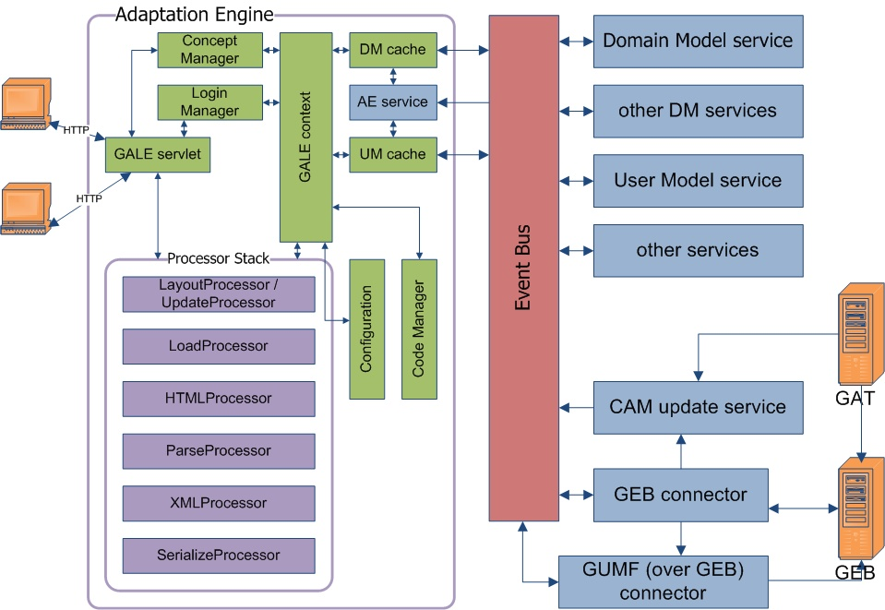
Notes:
This image shows the overall architecture of GALE. We will not study this in detail
In the following slides we look at two important details: the user model update process, using different caches, services and event bus, and XMLProcessor for adapting the content of a page.

Slide 30
Notes:
This figure shows the overall process of handling a request.

Slide 31
Logging in (GRAPPLE/GALE)
GRAPPLE uses Shibboleth for a single sign-on solution
GALE also has a stand-alone login handler
  upon first login, create an account
  after login, automatic redirect to requested page
  supports anonymous login
GALE also supports an Open ID login handler
  presents a login form to enter your Open ID
GALE also supports a “link-login handler”
  direct login from within an LMS, without Shibboleth, Open ID or a local account
Notes:
In GRAPPLE it is agreed that Shibboleth is used to create a single sign-on environment. Because each GRAPPLE component needs to know the exact identity of the user a setup with globally unique user identifiers should be used.
GALE can also be used stand-alone (without GRAPPLE). To this end it supports three alternative login procedures:
A stand-alone login handler automatically presents a login form when a user requests a concept. If the user does not yet exist (s)he can go to a registration form to create an account. After creating the account or after logging in the browser is automatically redirected to the originally requested concept. It is also possible to leave the entire login form blank, in which case an anonymous session is either created or resumed.
An Open ID login handler presents a login form for the user’s Open ID.
When GALE is configured to work with Open ID and with local accounts both login forms are displayed on the same login page. (The “handlers” generate these forms.)
GALE can also be directly connected to an LMS. Different LMSs support the same way to create a direct link from within the LMS to an external application. This works with a shared secret key. The LMS passes on the identity of the user to GALE and “authenticates” itself with the secret key. This works fine but is not secure (as the secret key can be intercepted in transfer or by checking page source on the client).
In this course we are going to use GALE in a stand-alone setting and we will thus use the stand-alone login handler and/or the Open ID handler.

Slide 32
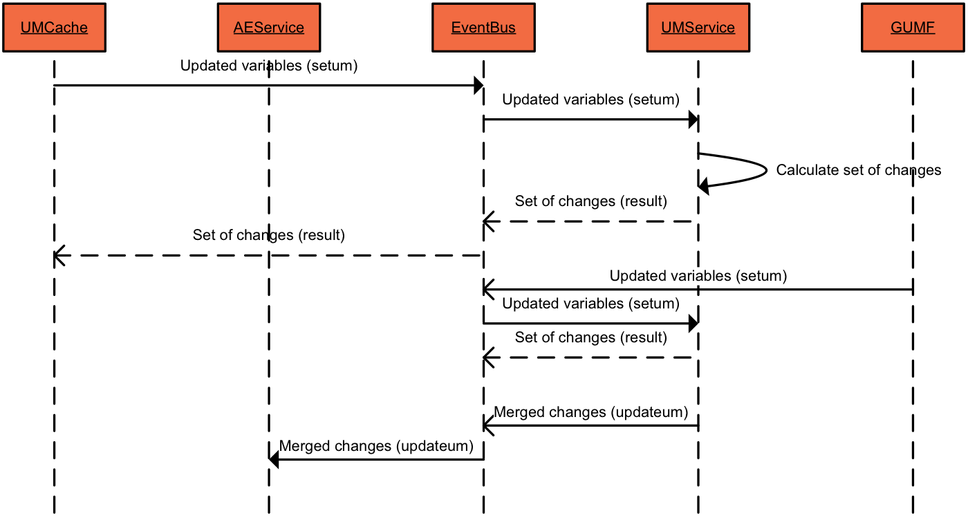
The process of user model updates
Notes:
This sequence chart shows how user model updates work, first (top) in case the user model update is initiated from an event within GALE (like when accessing a concept) and then (bottom) when the event comes from an external source, like GUMF.
The process shows that a user model update may be initiated in the adaptation engine, resulting in a UMCache update (left). This update is sent over the event bus to the UMService. Adaptation rules triggered by UM updates are executed inside the UMservice. This results in UM updates which are sent back to the adaptation engine’s UMCache (over the event bus). When the adaptation engine causes a UM update it waits for a response from UMService before continuing. The communication between the adaptation engine and the UMservice is thus synchronous.
An external service can send an update through the event bus to the UMService. This may trigger rules there, and the updated values (including the initial one coming from the external service) are sent back to the adaptation engine to update its UMCache. Communication with external services is asynchronous.

Slide 33
GALE Processors and Modules
Processors provide the default behavior of GALE
  UpdateProcessor: performs user model updates
  LoadProcessor: makes the resource data available as an input stream
  HTMLProcessor: creates proper XHTML from HTML data
  ParserProcessor: parses XML data of the resource
  XMLProcessor: does the actual content adaptation to any XML document, using a number of modules
  SerializeProcessor: serializes XML data found in the resource back to an input stream
  PluginProcessor: allows plugins to be added, that have direct control over the main output of GALE based on the current concept and user
  Sequencing through a linked list of processors, each “handling” some input and producing some output.
Notes:
GALE is an engine that processes XML files. XML goes in, and XML comes out. In most cases this will all be XHTML but it doesn’t have to be this way.
GALE starts with the UpdateProcessor to perform UM updates. This is done in order to decide which resource to load.
Next the LoadProcessor retrieves that resource and provides an “input stream” to the next processor.
If the input appears to be HTML the HTMLProcessor will change this into proper XHTML (so that the input is real XML).
The ParserProcessor creates a DOM tree in memory. All further operations work on the DOM tree.
The XMLProcessor uses Modules (see further) to perform operations on certain tags. The operations may change the tags or may conditionally keep or discard parts of the DOM tree.
The SerializeProcessor turns the DOM tree back into textual XML for output.
GALE actually places processors in a linked list to determine their execution order. Each processor “handles” some input, like an input stream or an internal DOM tree, and produces some output (perhaps again an input stream or DOM tree). If the required input is not available (already “used up”) the processor does nothing. The linked list allows for easy insertion of additional processors.
There is also a PluginProcessor that allows special operations, like changing attribute values.
GALE by default executes the UpdateProcessor before the LoadProcessor. This implies that user model updates are executed before the page selection. The choice of page to load thus depends on the new user model state. When you change these levels you can change this order and thus let GALE decide on the page before doing the user model updates.

Slide 34
Adaptation: the XMLProcessor
The XMLProcessor handles GALE tags through modules:
  IfModule, ObjectModule: handle conditional inclusion of fragments and objects
  HTMLModule: handles the HTML tag (and e.g. inserts a standard style sheet)
  VariableModule and AttrVariableModule: return the value of a user model attribute or an expression as simple text or as an XML attribute resp.
  MCModule: creates a multiple choice test (evaluated by a plugin)
  LinkModule: handles link adaptation (see also further)
  ForModule: “copies” a fragment for each element of a list
  (used e.g. for the lists of moons of a planet)
Notes:
When a file contains “GALE tags” they are matched with modules for handling them.
Examples of gale tags are <gale:if>, which results in the conditional inclusion of a fragment, and <gale:a> which results in link adaptation.
Other things are <gale:variable> tags used to insert the result of an expression (evaluated over the user model) into the presentation.
The MCModule is special for multiple choice tests in courses.

Slide 35
Plug-Ins for “special” operations
A Plug-In handles a request “completely”. Examples:
  form: allows GALE code execution based on information entered in the form
  export: exports part of the domain model in an XML representation of GALE: GDOM
    a “root” specifies the start of the concept hierarchy
  mc: used to evaluate a multiple choice test
  (different from the mc module used to generate a test)
  exec: used to execute GALE code upon following a link
  a page can thus tell the adaptation engine to execute arbitrary code!
  ajax: used by the ajax processor to indicate subsequent document retrieval (returns a new document if something has changed)
Notes:
In GALE a plug-in handles a request instead of the request going through the regular XML processor list.
The PluginProcess is the first processor to run. It checks whether the (http) request contains the parameter plugin and if it does it uses that parameter to redirect control to the specified plugin. We give a few examples, of which we will explain more of them more in detail later.
The form plug-in is used to handle forms input. GALE works with regular XHTML forms, but the “action” associated with a form is the form plugin.
The export plugin takes a parameter which indicates a concept, and then generates an XML representation of the domain/adaptation model part with that parameter as root. The XML representation language is called GDOM.
The mc plug-in is used to evaluate a multiple choice test. Such a test is also an XHTML form, but is handled differently from other forms. Note that the mc plugin only handles the evaluation of a test. To generate a test we use tags that are handled by the mc module of the XML processor.
The exec plug-in is used to execute GALE adaptation code when “clicking” on an item, almost always a link. It is thus possible to have the same link anchor with the same destination in different places and have it generate different user model updates by means of the exec plug-in used differently in the different places.
The ajax plug-in is used by the ajax processor to indicate subsequent document retrieval. It will (periodically) check for updates to the document and retrieve/insert it when there is a change.

Slide 36
Link Adaptation in GALE
Icons can be displayed around link anchors:
<property name="iconList”><list>
<value>("static-tree-view".equals(gale.currentView()) ?
(${#suitability} ? (${#visited}>0 ?
"pre:gale:/images/WhiteBall.gif” :
"pre:gale:/images/GreenBall.gif” ) :
"pre:gale:/images/RedBall.gif") : null )</value>
</list></property>
  In the view “static-tree-view” link anchors are preceded by a green, white or red ball, based on the “suitability” and “visited” attribute values of the current concept.
  This definition may be stored in the galeconfig.xml file (which is in spring format)
Notes:
In the Spring file galeconfig.xml the “LinkConfig” class is configured to define icons to be displayed in front of a link anchor or after the link anchor.
The presentation may consist of different views (like the static-tree-view which is an accordion menu) and the link annotation may be different in each view.
The definition for the link icons may be stored in the galeconfig.xml file but a concept can also have an attribute “link.iconlist” that overrides this default.

Slide 37
Link Adaptation in GALE (cont.)
The link anchor is of an adaptively determined class:
  A style sheet (default gale.css) defines the actual presentation for each link class.
  The default presentation is good = blue, neutral = purple, bad = black
  deviation from the default goes into galeconfig.xml
  <property name="defaultExpr" value=“( ${#suitability} ?
  (${#visited}>0 ? \"neutral\” : \"good\” ) : \"bad\” ) " />
  This default can also be changed by changing the value of the #link.classexpr attribute
  presentation attributes can be “inherited” from a special layout concept (or layout attributes of a parent concept)
Notes:
The adaptation of links happens in two phases. The LinkModule is configured to generates links of class “good”, “neutral” or “bad” depending on some expression, and to generate icons under certain conditionsl. A (CSS) style sheet defines the link colors to go with the link classes.
So defining the link classes and defining the presentation (color) of the links of the classes is specified separately. An author can easily change the colors while using the same expressions as other authors.

Slide 38
Creating GALE Applications
Creating a conceptual structure:
  domain model (concepts, conceptual relationships like “is-a”, “part-of”, etc.)
  conceptual adaptation model (pedagogical relationships like “prerequisite”)
    using a graphical tool GAT or
    using the adaptation language GAM
Creating content as a “website”:
  any XML format is supported, but XHTML is most commonly used
  use “gale” name space for adaptive elements
Notes:
Creating GALE applications is a lot like creating a “normal” web-based course text. It’s a matter of coming up with a structure and then writing the content.
A good author always draws up a structure for any book. Creating an adaptive course text is no different. First you define a domain model (DM) which structures the course domain. It’s much like creating an ontology. There are topics with subtopics, and conceptual relationships between concepts. We will illustrate this with a “Milky Way” example in which the “moon” Is an instance of a “satellite” and is a satellite of the earth, etc.
We also create a conceptual adaptation model (CAM) which also links concepts through relationships, but this time relationships that have a pedagogical meaning. When A is a “prerequisite” for B it means the learner should study A before B. It says nothing about a possible relationship between A and B in the domain model.
Then you have to create the actual course material. GALE can serve and adapt data in any XML format, although for a course text it is most likely that you will be using (X)HTML. If parts of a page need to be adaptive, like to conditionally include a text fragment or to annotate links to indicate whether they are suitable or not, you must use tags that belong to the GALE namespace. Pages can thus use HTML and GALE tags, but if HTML is the default namespace the GALE tags need to refer to the GALE namespace explicitly.
Note: the gale namespace is “http://gale.tue.nl/adaptation”

Slide 39
Two Types of Authoring
A concept can be associated with one resource (page); each page is authored separately.
A concept can be associated with a template resource (shared between many concepts); the template “includes” content fragments (with URLs from the concept’s attributes).
Notes:
There are two ways to author content: fully manual (every page authored separately) or template-based (pages follow one of a small number of templates). We show each method separately on the next few slides.
We will give examples of a page created with the template-based method.

Slide 40
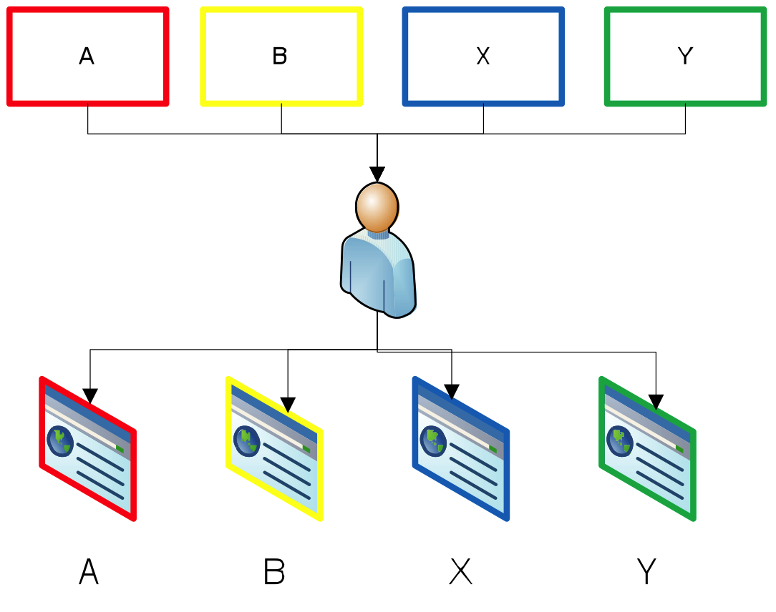
Authoring Pages Separately
Notes:
For every concept there is a page that is designed completely by hand. This allows for infinite creativity but unfortunately if most pages look the same they all share a template-like piece of HTML code that is copied many times. Any change to the design requires major effort.
In the example here pages A and B are very similar and X and Y are very similar.
Any change in the presentation style of pages A and B needs to be done twice, and the same for X and Y.

Slide 41
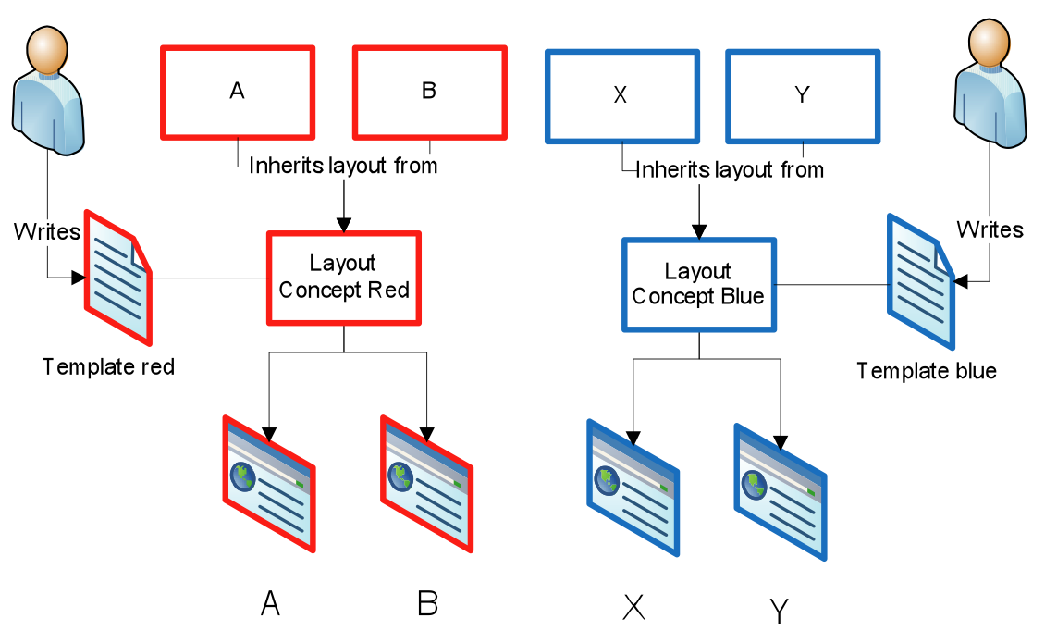
Template-Based Authoring
Notes:
It’s possible to design one or more template pages, with placeholders for content. The Milkyway example was created this way. So the many pages that look similar do not look similar by accident. They are actually the same page with content inserted through object inclusion.

Slide 42
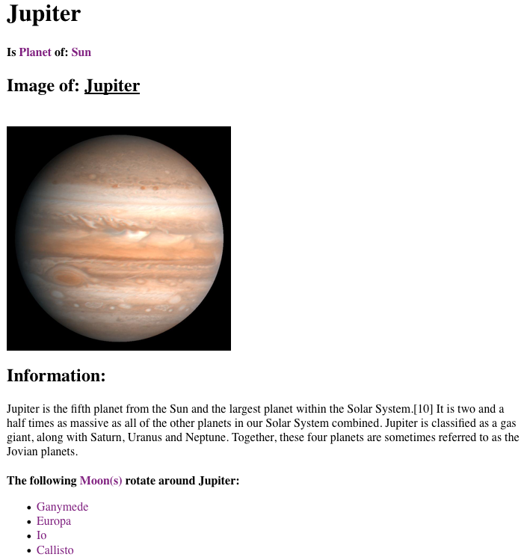
Page about a planet (in this case Jupiter).
Note the specific structure of the layout.
Notes:
The page about Jupiter is shown.
In addition to what was shown on the previous slide it also says “Is Planet of: Sun” with a link to the concept Planet and the concept Sun.
Note the specific structure of the presentation. The next slide will show Saturn.

Slide 43
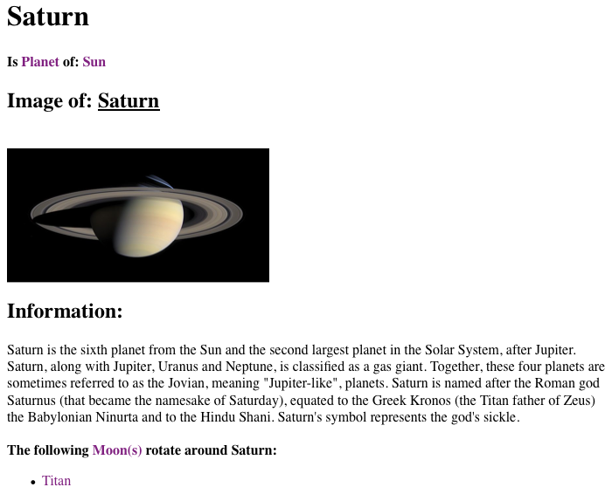
Page about a planet (in this case Saturn).
Note that the layout is identical to that of the Jupiter page.
Notes:
This is the page about Saturn. It has exactly the same structure as the Jupiter page.
If we want to change the layout of the pages of the planets, each page needs to be changed.
Clearly there must be a “better” way. We will show the template-based approach next.

Slide 44
The GAM (GALE Adaptation Model) Language
GAM is used to:
  define concepts
  define properties (semantic information) of concepts
  define relationships between concepts
  define user model attributes for concepts
  define rules for user model updates and adaptation
One GAM file can define a complete application
You can also combine a single concept definition and a single (XHTML) page into a single file… back to Interbook-style authoring…but only if we want to

Slide 45
The GAM (GALE Adaptation Model) Language
Example (of a GAM file defining just one concept):
http://gale.win.tue.nl/beer {
…
title "Beer and all it's aspects”
event `${#visited} += 1`
…
type 'page’
#suitability:Boolean 'true' //you are always ready to learn about beer
#resource 'http://gale.win.tue.nl/beer.xhtml’
#[visited]:Integer {
event '${#knowledge} = (${#suitability}?100:35);’
}
#[knowledge]:Integer ’0’
}
Notes:
Here is an example of a concept definition in GAM.
The concept has first of al an identifying URI, and then it has properties and attributes (possibly also with properties).
The title property is the string “Beer and all it’s aspects”. Note that because we used the double “ to delimit the string we are allowed to use the single ‘ inside the string.
The event property defines event code executed by the adaptation engine when the concept is accessed.
The type property is the string ‘page’ (for fun we used single quotes here). In GALE we sometimes do things for “page” concepts that we don’t do for other concepts, like counting the pages you have read and the number of pages you still need to read.
The suitability attribute is a Boolean which is volatile and computed by executing the expression ‘true’. So it is in fact constant in this case.
The resource attribute is a string (we don’t need to say that, it’s the default) and has the URL of a page to retrieve.
The visited attribute is a persistent attribute: its value is stored in the user model. When the visited attribute changes its event code is executed in the UM service.
The knowledge attribute is an Integer, initialized as 0.

Slide 46
The GAM Language (cont.)
Relations
  http://gale.win.tue.nl/beer {
  …
  // several examples of beer
  ->(example)beer/de_koninck
  ->(example)beer/palm
  ->(example)beer/duvel
  ->(wiki)http://en.wikipedia.org/wiki/Beer
  …
  <-(parent)brewing {
  … // optional inline definition of brewing
  }
  }
  note: incoming <- relations only needed for external concepts
Notes:
Domain level relations are indicated with -> (outgoing) and <- (incoming).
When a number of concepts are defined within the same GAM file the relationships are automatically known in both directions.
But when a concept from another GAM file (e.g. “brewing”) has a relationship to this concept (beer) reading this GAM file would not be enough to know that such a relationship exists. So it is possible to indicate incoming relations.
With relations it is possible to give an “inline” definition of the related concept, but this is probably not such a good idea.

Slide 47
The GAM Language (cont.)
  Inheritance: attributes are inherited by default,
  properties are not inherited by default
  http://gale.win.tue.nl/beer/de_koninck {
  ->(extends)../beer // inherit attributes from beer
  event + // inherit the event code (property)
  // code can be added after the +
  // add a condition to the inherited suitability attribute,
  // can with &= or |= for Booleans, += for strings
  #suitability:Boolean &=“${#interest} > 0.5”
  //overwrites the title property (no + used) if it existed in beer
  title ”De Koninck Beer (since 1833)”
  }
Notes:
The “extends” relation has a special meaning: it states that the concept “inherits” attributes from the concept ../beer (note that ../ is needed to refer to beer).
User model attributes are inherited automatically.
Properties can be inherited by naming them. (There is also a way to inherit properties by default. We will see that later.)
With a “+” you can append to their value or just keep the value (if you don’t write anything after +) and you can also just give a new value to overwrite the old one.
Volatile attributes typically have as value an expression (to compute the value). You can add to this expression using &= (add with logical and), |= (add with logical or) and += (add to the string). Note the differences between + to add to a property and += to add to an attribute.

Slide 48
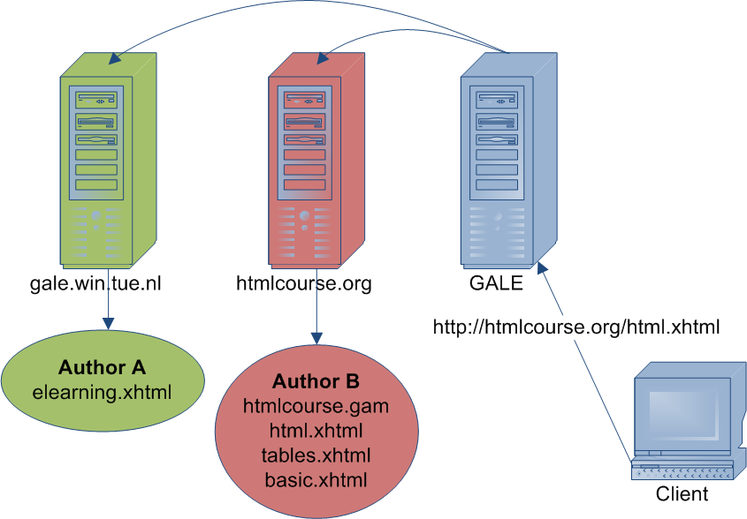
Open Corpus, Open Model Adaptation
Notes:
What’s special about GALE is that as an adaptation engine it can retrieve concept definitions (GAM files) and pages (XHTML files) from possibly different web servers. So Author A can write a course text, use adaptation definitions from author B and perhaps also some pages from author B, and the course can be served by GALE running on yet another site.
Can you see what this effectively means?
GALE can act as a proxy server that performs adaptation for users who can login on that server.
Currently we run a server on gale.win.tue.nl which allows anyone to log in anonymously and that allows anyone to log in using an Open ID. This is of course not sustainable in the long run.

Slide 49
Security… is GALE a security nightmare?
The GAM event code (expressions, assignments) is Java code (running on the server)
  GALE executes the Java code in a secured environment (using proven Java mechanics; protects server)
You could write GAM code that changes some other user’s user model
  GALE only allows reading/writing the user’s own user model (any application can read all info)
  This implies GALE cannot easily do “group adaptation”
You could write GAM code that changes user model info about a different application
  GALE only allows modifying user model data within the own application
Notes:
Open model adaptation as presented before can be a security nightmare…

Slide 50
Extending GALE
GALE can be extended by writing new parts:
  Module: for handling specific XML (XHTML) tags
  View: for generating content (based on DM/AM)
  Plugin: for handling a request directly/completely
  Service: for new service on the event bus
  Processor: for handling a specific type of data
  Login Handler: for new login/identification method
  Code Manager: for writing adaptation rules in a different language (other than Java + GALE EL)
The GRAPPLE Deliverable (D1.3c) and the PhD thesis on gale.win.tue.nl have technical details.
Notes:
GALE can be extended in many ways. For the assignment you probably won’t need to do any of this, as you can create a lot of adaptation using the GALE (Java) code and you can use CSS for tremendous variation in presentation style. But if needed you can extend GALE in 7 ways:
Adding a module allows for handling specific tags. If you want to do some clever adaptation to a <video> tag, you can do that…
GALE has predefined views for generating content, for instance for a navigation menu. You can add views to generate different domain presentations, for instance if you would like a graphical (graph-based) presentation of the concept structure, or of the user model, for instance if you would like to present a bar chart of knowledge values.
GALE has a plugin for forms and multiple-choice quizzes for instance, but you can add plugins for handling special types of requests.
On GALE’s event bus there are Domain and User Model services but you can add more, for instance to accept new adaptation models in a different new format.
GALE has a processor for XML documents. If you want you can add a processor for different types of documents, maybe for Latex or Word…
GALE has different login handlers that show a login screen. We typically use the stand-alone login handler and the open id handler but you can add more.
GALE has a Java based adaptation code manager. If you want you can replace this by a different one (but that is a *lot* of work).
We do not describe how to do this. Check out the appropriate GRAPPLE Deliverable D1.3c or David Smits’ PhD thesis on gale.win.tue.nl.

Slide 51
Information Sources
gale.win.tue.nl
  download of GAT+GALE
  GRAPPLE tutorial (also accessible through Sakai)
  PhD thesis written by David Smits:
  http://gale.win.tue.nl:10080/gale/concept/http://gale.win.tue.nl/thesis/thesis
  (note that this thesis is still awaiting approval)
  GRAPPLE D1.3c, also available on Sakai
  note: some of this deliverable is outdated (the thesis is the most recent information source)

